Slide 1
W-2s AND GREENSHADES
Notes:
Welcome to the 2022 W2s and Greenshades Training. We appreciate you taking the time to prepare your company for success with year end filings.
A few housekeeping items before we get started:
All attendees are in listen-only mode to reduce background noise
If you have any questions, please use the Q/A box, we will respond to your questions as we get to the applicable session or at the end where we have a section for Q/A.
This webinar is being recorded and will be available in the KB along with the powerpoint for your reference as you work through year-end.

Slide 2
Agenda
WE’RE GOING TO COVER…
1
Year-end preparation
4
Helpful resources
2
W-2/ tax filing
5
Q&A
3
Troubleshooting

Slide 3



It’s nice to meet you!
BECKY FOX
SR. PRODUCT TRAINER
Notes:
Been with Avionte for 8.5 YEARS– 14 plus years in staffing – experience on both sides of Avionte.
Worked specifically with year-end team for years.

Slide 4
Disclaimer
The information in this webinar is being presented by Avionté as a general informational and educational service to its clients and prospective clients.
This information should not be construed as, and does not constitute, legal advice nor accounting, tax, or other professional advice or services on any specific matter.
Participants should consult with their counsel or other professional advisor before acting on any information contained in this webinar.
Avionté expressly disclaims all liability in respect to actions taken or not taken based on the contents of this webinar.
Notes:
This disclaimer will specify the scope of what Avionte can do for you in the year-end process.
Can not stress enough that you need to consult with legal or tax decisions that concern your business.

Slide 5

Expectations
ENSURE SUCCESS BY…
Attending at least one full year-end tax and W-2 filing webinar
Planning ahead and being aware of due dates
Consulting the Knowledge Base
Staying in the know
Notes:
We want to set you up for success and the way to do that is preparation. Defn of preparation states “something done to get ready for an event or undertaking.”
Well, year end for those of you who work in the back office can be an undertaking……
Bold Bulletin updates – come out weekly with links to webinars, compliance information, Greenshades pricing….

Slide 6
Year-end preparation
Notes:
Let’s talk about the preparation needed for your successful year end.

Slide 7
Quick check
BEFORE YOU GET STARTED…
Must use Avionté as your Back Office/ Payroll
Must track information properly in your database
Must be on Greenshades Basic Package with Avionté
Allows you to pass XML file to Greenshades for quarterly and annual filings
Can sign up with your AD/AM if needed
Notes:
A few quick items to check first before you get started.
Those who outsource payroll are off the hook!
Good data in – good data out…. Get asked SSN verification question a lot – We recommend you do you SSN verification using Everify. If you complete through Greenshades it takes, several hours/days to get results. You can also use the services provided by the SSA – you can upload a file to the SSA Business Services Online (BSO) https://avionteclassicsupport.zendesk.com/hc/en-us/articles/360047908793-Social-Security-Number-Verification-Services-SSNVS-Feeds-and-Reports
If you do not yet have Greenshades, you can chat with AM/AD to get signed up. There is paperwork that needs to be completed to get a registration key for the integration.

Slide 8

Who is Greenshades?
Payroll Tax Filing Solution
Avionté partner accessed from the core application
Can e-File quarterly and year-end Federal forms like 1095-Cs, W-2s, 940 & 941
Can build quarterly and year-end state and local filings like unemployment and W-2s
Optional additional service for printing/mailing employee year-end forms
GREENSHADES
Trusted payroll tax filing solutions
FEATURED
Notes:
I mentioned Greenshades in that last slide…… so who is Greenshades?

Slide 9
Important date: JANUARY 31
W-2s due to employees
W-2s filed with the SSA
940 and Schedule A due to IRS
1099s mailed and filed
JANUARY 2023
SUN | MON | TUE | WED | THU | FRI | SAT
1 | 2 | 3 | 4 | 5 | 6 | 7
8 | 9 | 10 | 11 | 12 | 13 | 14
15 | 16 | 17 | 18 | 19 | 20 | 21
22 | 23 | 24 | 25 | 26 | 27 | 28
29 | 30 | 31
Notes:
Put a plan in place and start early!! January 31st is the key date!

Slide 10



Distribution
OUTSOURCING:
PRINT IN HOUSE
Order 4up Blank paper for W-2s
Preferred vendor: Nelco
Run W-2 4up Blank report in Report section of Avionté
ELECTRONIC FORMS
Post W-2s on Avionté Employee Portal
  AviontéBOLD: Electronic W2 Access and Consent
  AviontéCLASSIC: Electronic W2 Access
Employees must give consent for electronic W-2 only
Notes:
Distribution options
Print in house – you print your W2s directly from Avionte and distribute to emails via mail or direct distribution
Outsource
Greenshades, Solv and Nelco – preferred partners, you can contact them to discuss the amount of paper you will need, costs, etc
Beware! There are additional costs using these vendors that are outside of and not covered with your monthly Avionte fees.
Electronic forms via the employee/talent portal – but employee/talent consent is required
We have a standard consent e-doc, or you can ask through interview question, etc. but it’s easier if you’ve been doing it throughout the year – trying to get them now will be difficult
Links shown here for KB articles for the process
Saves on the # of forms you are mailing, saving you postage costs
Print & mail partners – these are the ones that we have partnerships with and therefore have an export created that will easily send the data to the vendor for printing. All partners charge a fee to print & mail. Otherwise, you can do this in-house for free
Electronic W2 Info AQ will tell you which employees/talent have consented to receiving the W2 electronically.

Slide 11
Distribution pricing** 2023
DATE RANGE | PRICE
JAN 1 – JAN 4 | $0.75
JAN 5 – JAN 09 | $2.19
JAN 10 – JAN 15 | $2.74
JAN 16 – JAN 20 | $3.29
JAN 21 – JAN 23* | $3.84
JAN 24 – FEB 13 | $4.17
FEB 14 - ONWARD | $4.39
GREENSHADES
Trusted payroll tax filing solutions
FEATURED
There is an additional $0.99 upload fee per form.
*Last date for guaranteed January 31st delivery: 01/23/2023
**Additional pages $0.75 per page
Notes:
Greenshades pricing chart for print and mail – just note that the longer you wait, the more it costs. The last date for guaranteed on time delivery to employees is 01/23/2023.
This means you are asking Greenshades to print and mail them for you, so you will receive a separate invoice from them for the cost of that service.

Slide 12
Generate Q4 data
Notes:
Step 1: Generate your Q4 data in Greenshades
This is used to collect the data for your w2s, 1099s and the quarterly data that you still need to do for q4 filings

Slide 13





Generate Greenshades feed and XML
PROCESS
Generate Greenshades weekly.
SELECT
Select Supplier, Year, and Quarter.
GENERATE
Generate feed & XML.
RESOLVE
Review and resolve errors.
Notes:
Step 1: Generate your Q4 data in greenshades
This is used to collect the data for your w2s, 1099s and the quarterly data that you still need to do for q4 – you can do this at anytime – do not need to wait until 1/1!!
To do this –
Go to your Weekly process in the core app (back office/Bold back office)
Select supplier, etc
Click the generate Feed & XML button
need to do 1 supplier at a time if you do have multiple……
Repeat for multiple suppliers
Click the button for generate feed and xml
It’s taking a snapshot of your back office data and processing it into your forms and annual quarterly filings
You might receive errors because the feed is not only processing, but it looks for non-matching data or missing items.
Next step is to review and then resolve any errors you find, and then once you’ve resolved those errors – you want to go back and repeat that process of generate feed and xml
You can repeat that process of generating the feed and xml as many times as you want between now and filing. It just refreshes that snapshot of back office data
Weekly Process > Generate Greenshades
Select Supplier, Year, and Quarter
Generate Feed & XML
Review & resolve errors
Q4 = W2s, 940/941
Q4 ACA = 1095-Cs

Slide 14
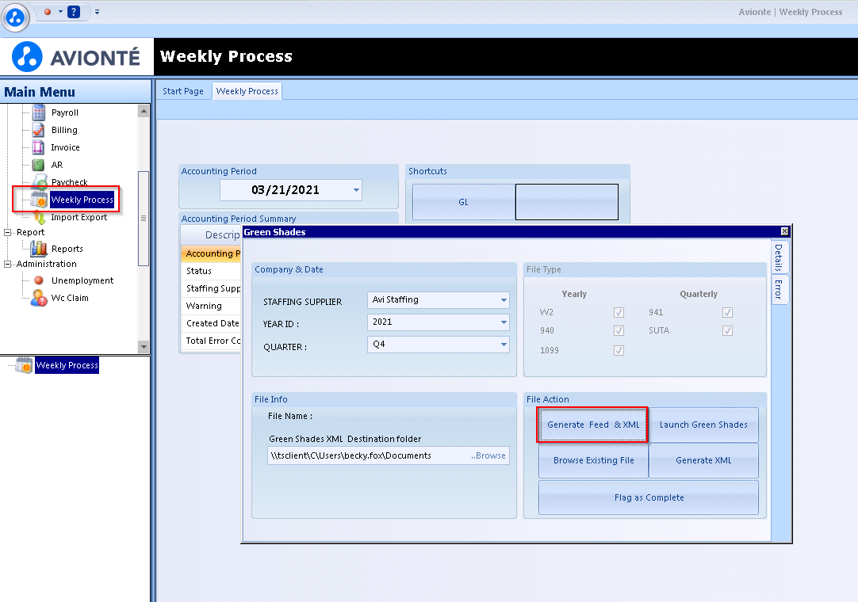
Generate Feed & XML
First step in the year-end process!
  Must follow this process even if you are using a different vendor
Feed: Captures most up-to-date information in the database to populate reports such as the W-2; checks for errors
XML: File type to pass to Greenshades to print and/or e-File your reports; contains data for ALL quarterly filings
Notes:
Let’s walk through the process with screenshots
Generate Feed & XML button is our first step
Weekly process in the main menu and clicking the generate feed & XML button; also available in the Actions menu
YOU CAN GENERATE THE FEED TO POPULATE THE W2 4UP REPORT AND THE GET W2 DETAILS. YOU CAN GENERATE THE FEED AND NOT FILE UNTIL JAN.
When you click that generate feed and xml button, the system is doing 2 things.
Processing a feed of data
Creating an xml file
The feed is that snapshot of back office data – and it’s pushing that or feeding that into the reports in the core application
The xml is a file type that will save to your computer for greenshades
All data for q4 and your year end tax filing

Slide 15
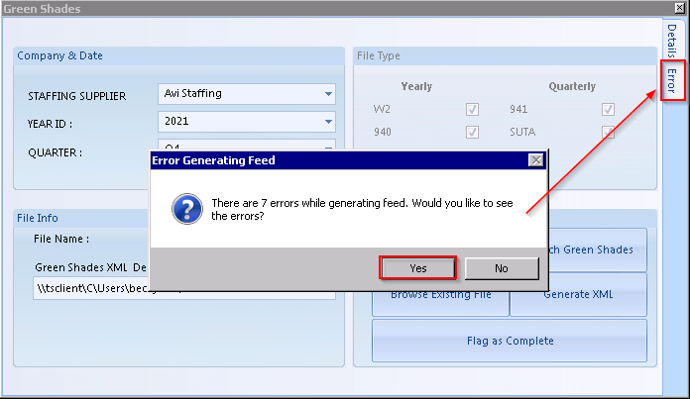
Review errors
Notes:
After you click the generate feed and xml button, you may get a pop-up indicating there are errors – DO NOT IGNORE THESE ERRORS (IF SEVERE, CAN’T MOVE PAST THEM)
You will need to review and resolve those before you proceed with efiling or with printing any forms
In my case, I have 7 errors
If I click yes to see them, it brings me to the errors tab and I can toggle back and forth.
The errors screen is grouped into 2 different sections
Severe errors – which we definitely want to fix before – can’t move past
Warnings – those can be bypassed, but you should review and attempt to resolve as possible
ERRORS CAN BE REVIEWED IN THE GREENSHADES WINDOW OR USING the VIEW GREENSHADES ERRORS AQ in Reports section

Slide 16
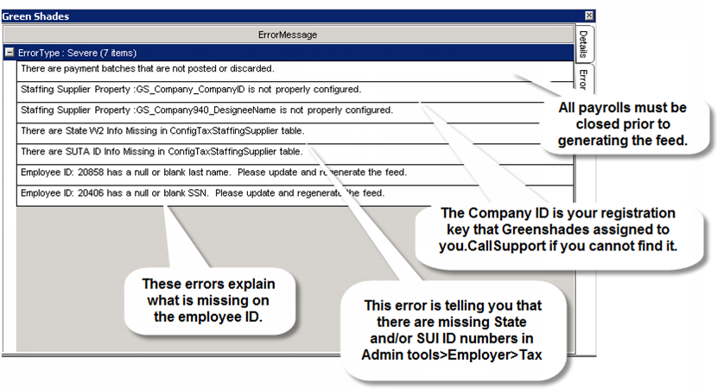
Review and resolve errors
GREENSHADES ERRORS
State W2/SUTA ID info missing
Employee has more than one address marked ‘IsResidentAddress’
Employee missing SUI wages
Negative SUI Wages for employee
Greenshades Error Resolutions & Troubleshooting article
Notes:
Errors separated by Warning & Severe. Warnings can be bypassed by going back to Details side tab and clicking Generate XML. Severe must be resolved.
Fixes for these common errors on next slide.
Screenshot here are some common errors in greenshades – the main four are listed
Additionally on my screen is a link to the kb article about greenshades errors and the steps to resolve them.
IF YOU RECEIVE A MESSAGE “MISSING ADDRESS, ZIP CODE, ETC” and you are using BOLD FO, best practice is to go into the FO and fix the error then regenerate feed and XML

Slide 17
COMMON ERRORS | RESOLUTION
State W2/SUTA ID info missing | Means a new state was added in this period Fix in Admin Tools > Employer > Tax > Tax EIN tab Add ID # for State or SUI Enter 0 for states in which you do not do business Regenerate Greenshades Feed & XML
Employee has more than one address marked ‘IsResidentAddress’ | Navigate to Employee profile Determine which address is correct Alter incorrect/duplicate Address Type and uncheck Is Resident Address Click Save Address If needed, re-enter Employee > Address screen, right click on incorrect/duplicate address and Delete Regenerate Greenshades Feed & XML
Employee missing SUI wages | Means there may have been converted data or issues with transitioning Contact Avionté Support – we will need to troubleshoot
Negative SUI Wages for employee | Means a check was reversed/voided in one quarter when the Employee was paid/working in that state in a previous quarter Can ignore or amend ALL returns Employee will not show on Unemployment return 941, State WH, quarter-end filings unaffected
Notes:
Resolutions for the most common errors
If you get these errors, you can reference this deck or go to the KB article previously mentioned
Call out – employee missing SUI wages error. This one requires Avionte support assistance, the others you can resolve on your own.
Issues with converted data, or data transition – contact us if you get this
The others are pretty simple to resolve – usually missing data such as zip code or a quick data edit in the core application.

Slide 18
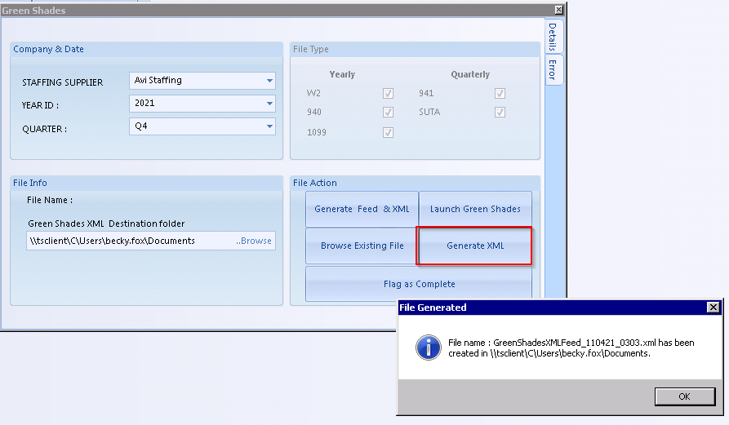
Generate XML File
Can skip if Feed & XML generates without errors!
Will create XML file saved in XML Destination folder
  Allows you to “bypass” expected errors
XML will automatically be created if no errors are found after clicking Generate Feed & XML
Notes:
Next step, only needed if you received errors
If you generate the feed and xml and there are no errors – it will automatically generate the XML file and place it in the folder you designated
However, if you want to bypass any warnings that you might have received (minor warnings); you can always come back to this tab and force the generation of this xml by clicking the create xml button
This folder will save this file to whatever file you’ve designated on your personal computer
When you launch greenshades, you will be able to see your data in there – you don’t need to upload it
Generate Feed now and start to see if there are any errors – don’t have to wait for year end! You can do this at any time during the year!

Slide 19


Reviewing and distributing W-2s
W-2 REPORT 4UP BLANK
Printable W-2 format
PRESSURED W2
Printable W-2 format
EMPLOYEE W2 INFO AQ
AQ version to review in bulk
* Q4 2022 Greenshades feed must be generated before these reports can be run.
Notes:
Once you generate the feed for Q4, you will be able to review your forms
Our w2 related reports will only work if you’ve generated that greenshades feed and xml for q4 of the year you are reporting
Titles of helpful reports
W2 report 4 up blank – just like what you need to send to employees; can be printed directly out of avionte on 4up blank stock and mailed to employees
Pressured w2 report if you have the different formatted stock from one of the previously mentioned vendors, you can use this to print and mail
Employee w2 info aq – this is an advanced query version, looks like an excel spreadsheet so you can search and review multiple employee's data

Slide 20
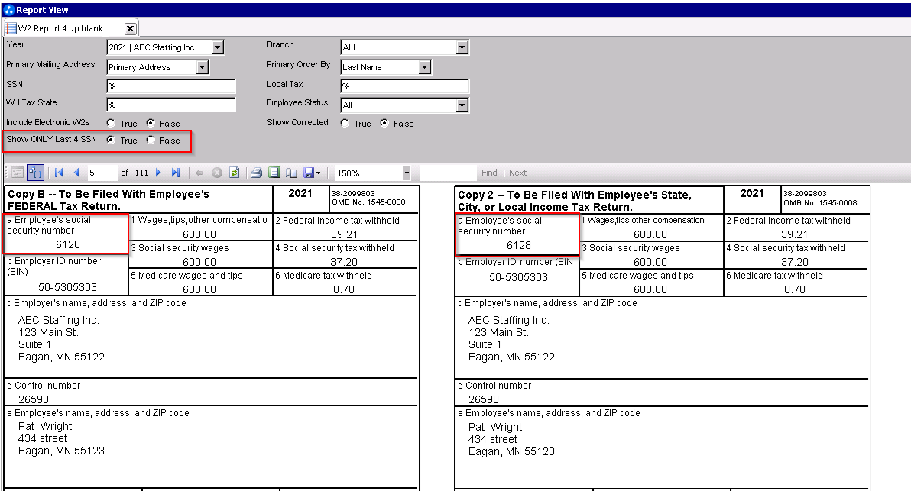
Truncate SSN
W2 Report 4 up blank
Ability to truncate the SSN
Parameter “Show ONLY Last 4 SSN”
If True, only last 4 of the SSN will display when printing W-2s
If False, full SSN will display
Standard Report – W2 Report 4 up blank
Notes:
For W2 reporting – can truncate SSN in W2 Report – optional if you want to mask full SSN

Slide 21
Other Useful Reports
TAXES SUMMARY
  Taxes Summary Lite sums by supplier/branch, shows tax due amounts in summary form
  Taxes Summary sums by supplier/branch, broken down by state and jurisdiction
TAX REMITTANCE ER
  Shows detailed list of employees associated with an employer tax
  Broken down by tax type
GET W2 DETAILS AQ
  Shows totals for W-2s and employee related taxes
  Can filter by total W-2 count or EE/ER Summary
Notes:
In order to help you review your w2 reports – we have a couple other useful reports
Help double checking what was produced on the w2s
Taxes summary and summary light
Sums your taxes by supplier, branch, shows tax due – so it’s great for reviewing quarterly tax filings
Tax remittance ER
Employer tax info broken down by tax type
Get w2 details
Totals for w2s, see your count to order stock
EMPLOYEE W2 INFO AQ ALSO HAS THE INFORMATION OF WHICH EMPLOYEES HAVE CONSENTED TO RECEIVING W2s ELECTRONICALLY.

Slide 22
e-Filing State W-2
Notes:
After you’ve generated your greenshades feed and run your w2 reports
End of January you need to efile with the state and the SSA
Due date is Jan 31st
You probably want to do it before then – plan in advance

Slide 23
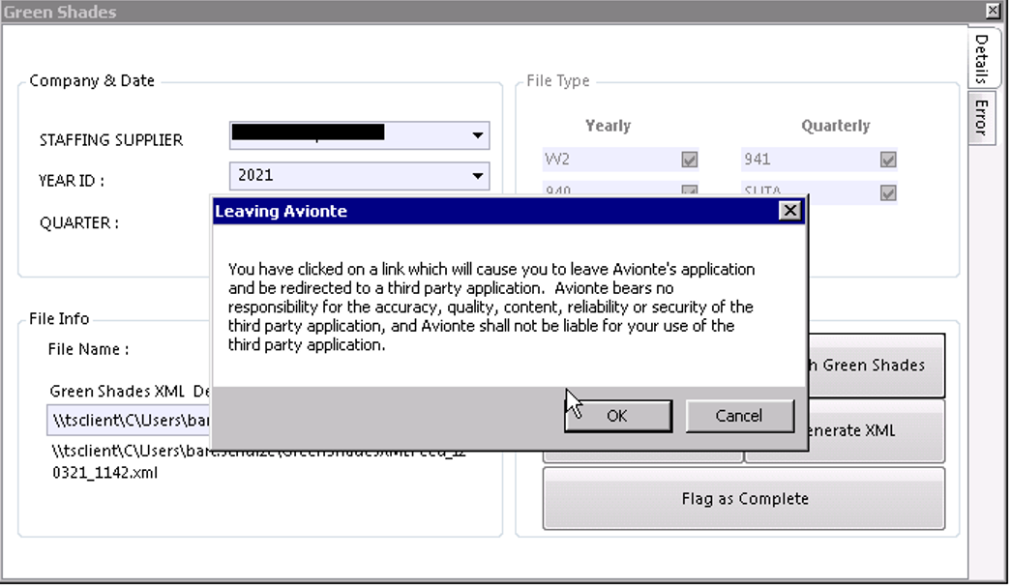
Launch Greenshades Message
When launching Greenshades, you will receive a message indicating that you are being redirected to a 3rd party application.
Notes:
When launching the Greenshades integration in the back office, you will receive a pop-up message indicating the redirect to a 3rd party application. That means if you run into issues on individual state tax websites that you will need to work with them to resolve any issues that occur. (varying file formats, uploading outside of open window to file, etc)

Slide 24
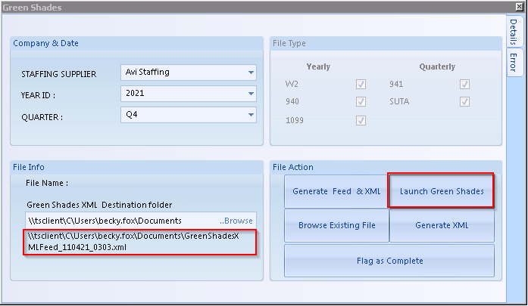
Launch Greenshades
Greenshades Tax Filing Center application opens in a separate window
May be prompted for Registration Key
  Copy/paste from GS_Company_CompanyID property in Admin Tools > Employer
  Click Validate
Notes:
To efile, repeat that generate greenshades feed and xml process – to take a snapshot of your current data
Make sure you rerun this after you correct your errors
Click the launch greenshades button to open up the GS tax filing center in avionte
You may be prompted to enter a registration key by a notice that says – you must enter a valid registration key in the settings screen
If you are prompted, you might have gotten it when you signed up
Admin tools > employer section > details tab > reg key there
You can copy and paste from there
Enter the key and hit validate

Slide 25
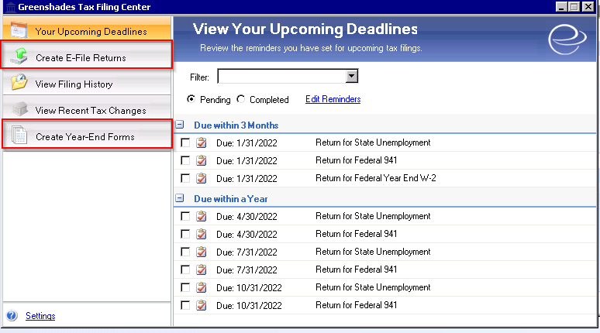
Greenshades: Tax Filing Center
E-FILE RETURNS
Build Federal, State and Local E-files to submit
YEAR-END FORMS
Build year-end forms to provide to employees
Have Greenshades print and mail forms to employees
Incurs additional cost
Notes:
Greenshades is an integration and you access it through our software
Two main sections you will work out of are create e-file returns or create year ends form if you’re having greenshades print your forms for you

Slide 26
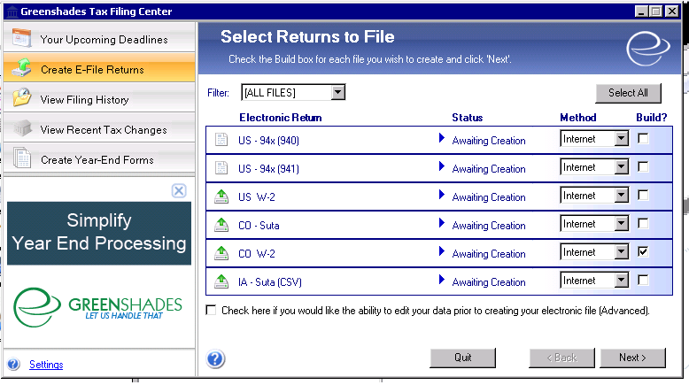
Create: e-File returns
E-FILE RETURNS
Create E-File Returns
Select the Build? Checkbox next to State W-2
Click Next
Notes:
Efiling your w2
Click the create efile returns table
List of all the potential reports you can build based on your data
Click the build checkbox on the forms you want to use
Click next

Slide 27
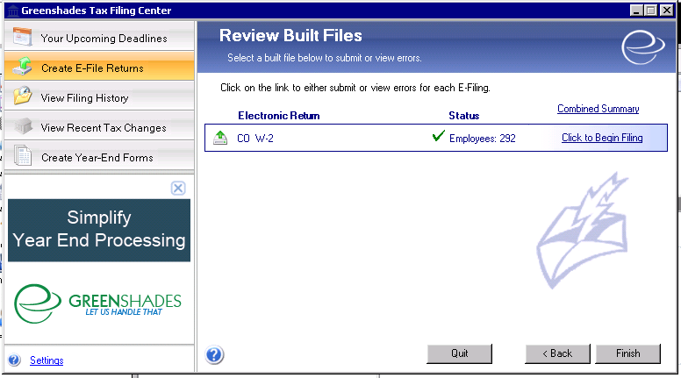
State W-2
STATE W-2
Select the Click to Begin Filing link
Notes:
Nice thing about greenshades is it kind of walks you through the process
When you click next, shows you the files you chose to build
Click the begin filing hyperlink

Slide 28
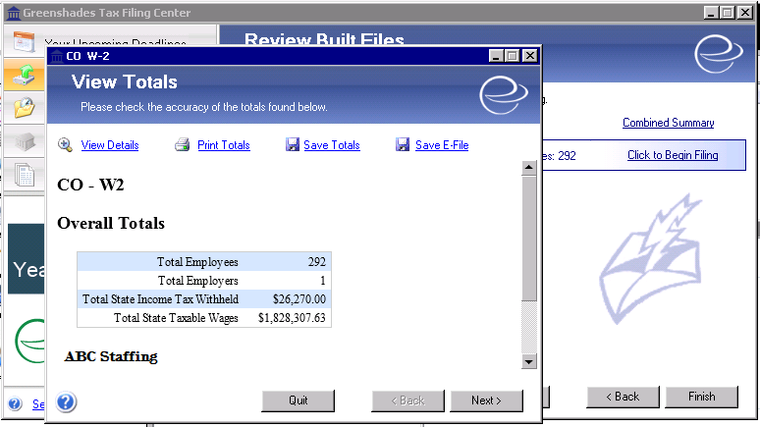
State W-2
STATE W-2
Review & Save Totals
  Review overall details against taxes summary reporting
Save E-File
  Save E-File to manually upload file to State website
DO NOT change file name or type of E-File!
Notes:
Once you click that, it brings you to a second window of the totals from that build
We recommend that you save the totals and the efile from this screen
When you save the efile, don’t change the name or type
Best practice, create a folder for it on your computer with very clear name and then save the file into there
When you save your titles, the name doesn’t matter

Slide 29
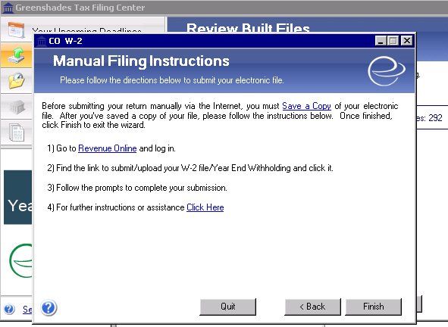
State W-2
STATE W-2
When you save the E-File, instructions for Manual Filing will be provided
Click Finish to go back to Create E-File
Notes:
Next, brought to manual filing instruction for the state
Each state has it’s own process, so greenshades will provide specific instructions on how to do it for your state
Make sure you read this before you hit finish – maybe take a screen shot
You can click finish to go back to that reviewing the build files screen
You can then begin your second form, if you have multiples to print
This process is the same for annual reconciliations, local w2s and state unemployment
*****clarify as state w2s, not federal

Slide 30
E-Filing Federal W-2
Notes:
After you’ve generated your greenshades feed and run your w2 reports
End of January you need to efile with the state and the SSA
Due date is Jan 31st

Slide 31
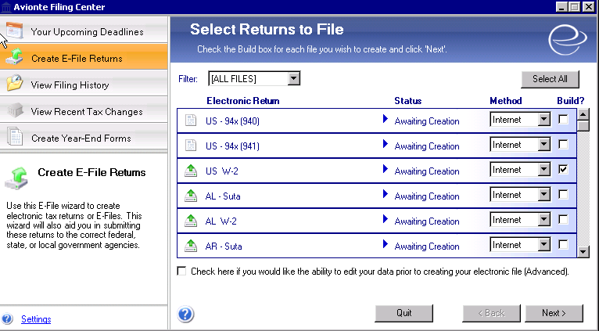
Create e-File returns
E-FILE RETURNS
Launch Greenshades
Create E-File Returns
Select the Build? Checkbox next to US W-2
Click Next
Notes:
Again, we access the Federal W2 efile under “Create e-file returns.

Slide 32
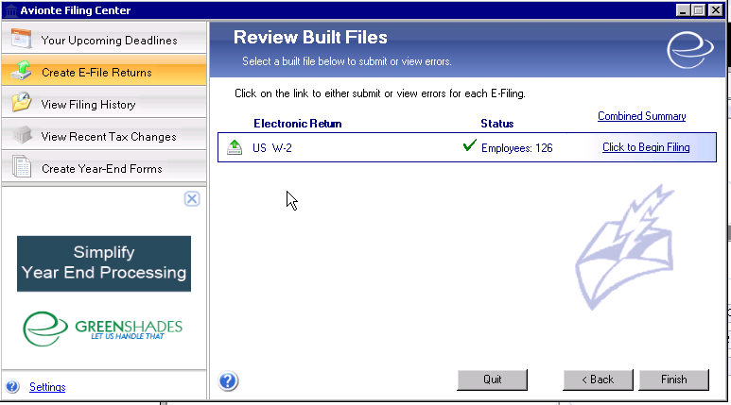
Federal W-2
FEDERAL W-2
Confirm number of employees in the file
Select the Click to Begin Filing link
Notes:
Again when you get to this screen you can see the # of employees in the file and select the “Click to begin filing” link,

Slide 33
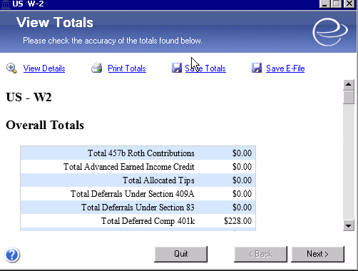
Federal W-2
FEDERAL W-2
Review & Save Totals
  Review overall details against taxes summary reporting
Save E-File
DO NOT change file name or type of E-File!
Notes:
Review, Review, Review.

Slide 34
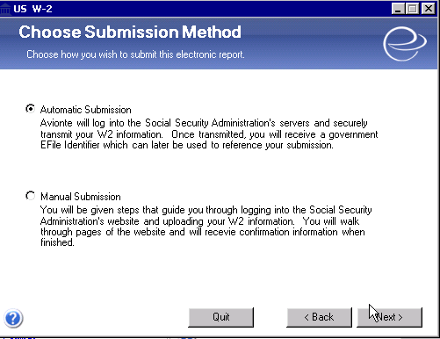
Federal W-2
FEDERAL W-2
2 options for submission
Select ‘Automatic Submission’ for Greenshades to file your US W2
Select ‘Manual Submission’ to upload the file to SSA on your own
Select Next
Notes:
2 choices – if you want to proceed with automatic submission – this means that you are allowing Greenshades to file on your behalf to the IRS.
If you want to upload the file to the SSA yourself you can click on Manual submission.

Slide 35
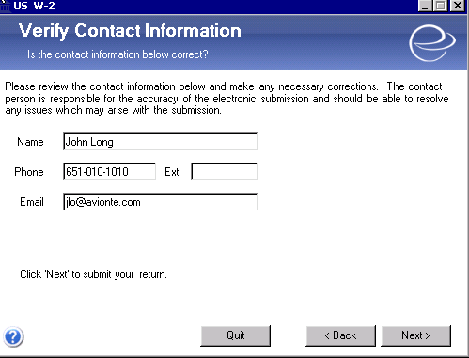
Federal W-2
FEDERAL W-2
Verify Contact Information
Select Next
  Once you select ‘Next,’ you are finished and have submitted your forms to the SSA. You will be directed to the initial page where you build your files.
Notes:
It is important to verify your contact information. If there is any follow-up to your filing, this is who they will contact.
This can be changed again in Admin Tools – this is the original contact that was submitted when you signed up for Greenshades so if you need to change it, now is the time to do it.

Slide 36
e-Filing 940
Notes:
940 – quarterly reports

Slide 37
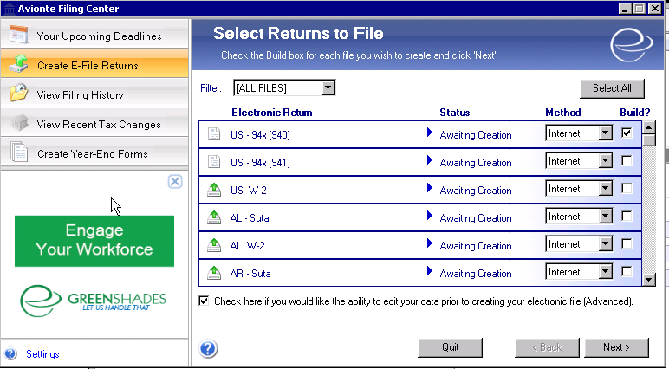
Create: e-File returns
E-FILE RETURNS
Launch Greenshades
Create E-File Returns
Select the Build? Checkbox next to US – 94x (940)
Click Next
Notes:
For those that have multiple suppliers…. You need to build the 941 and 940 separately since you need to use the editor to complete those forms.
All SUI and W2’s you can build all at the same time but they will build file by file one at a time.

Slide 38
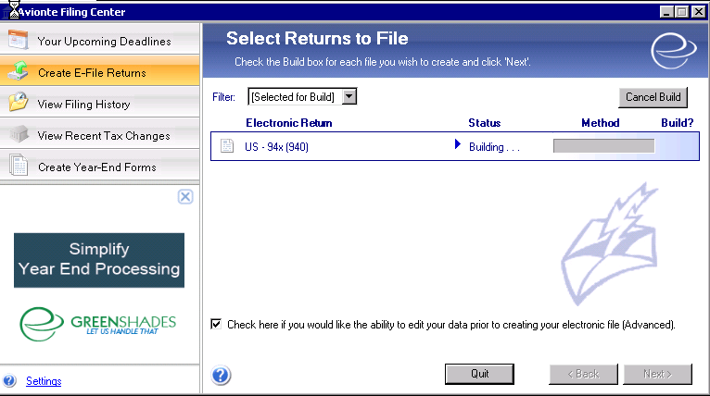
e-File 940
940
As the file is being built, select the check box at the bottom
Notes:
You can see the progress of the file as it is being built.
Check the box to edit your data prior to submitting.

Slide 39
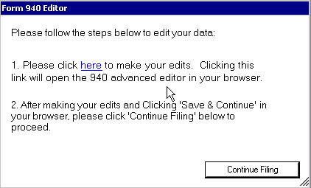
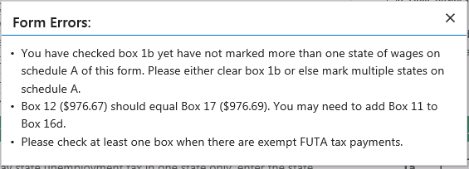
e-File 940
940
Click the ‘Here’ link to make edits
You will then see the form errors that need to be resolved
Notes:
When you click the “here” you can see the errors and make edits.
Examples of the errors are listed.
Best practice – review errors

Slide 40
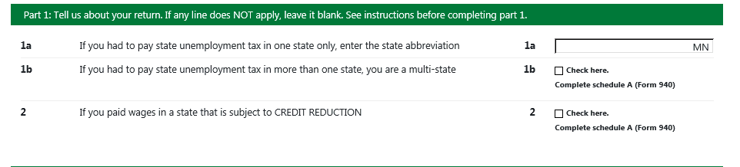
e-File 940
940
Resolve errors
You have checked box 1b yet have not marked more than one state of wages on schedule A of this form. Please either clear box 1b or else mark multiple states on schedule A.
Notes:
Here is a common error for the 940.

Slide 41
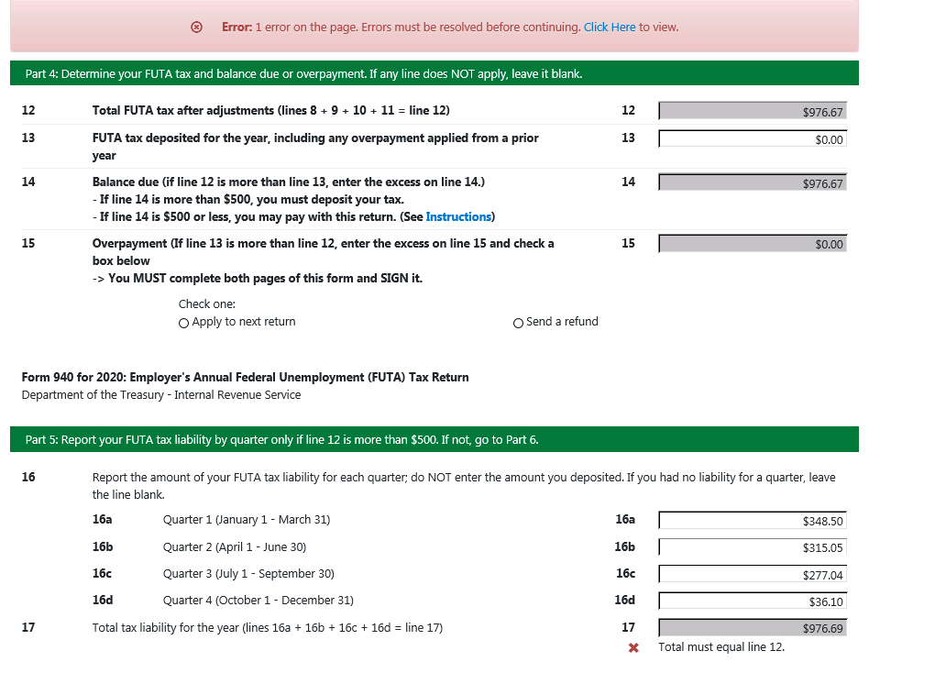
E-File 940
940
Resolve errors
Box 12 (976.67) should equal box 17 (976.69). You may need to add Box 11 to Box 16c.
  Please check at least one box when there are exempt FUTA tax payments
Once errors are resolved, file will be built and ready to file through Greenshades.
Notes:
Another error you may see….. All of the common errors you experience will be in our Greenshades troubleshooting article in the KB.
If you do have an error you can’t get past and need help from our Support Team, you would have to complete a ticket with screenshots and call into the Support Center.

Slide 42
W-2 troubleshooting
Notes:
Troubleshooting - now that we’ve been through the process of creating, distributing and efiling your w2s – let’s talk through some common questions we get

Slide 43
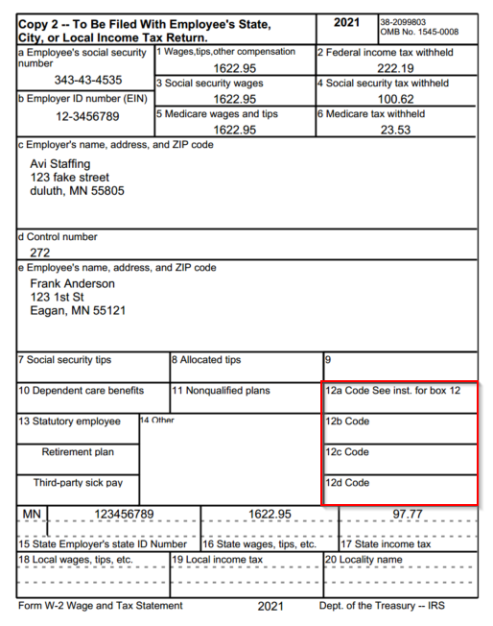

“Box 12 isn’t populating the appropriate data.”
Admin Tools > Transaction Type
W2 Box, W2 Label
Notes:
Box 12 – can have multiple labels within it and house multiple kinds of data
By default, Avionte doesn’t put anything here
You have to tell the system what you want in box 12
Do this through admin tools, in your health insurance transaction types – there is a w2 box and a w2 label – verify that this is set up.
For example, box 12 dd – healthcare contributions
The process would be that you have a contribution linked to a deduction and those transactions are added together so both the EE and ER portions flow into Box 12.
Enter the box and label, click save, regenerate feed and xml and see it populate on your w2s

Slide 44
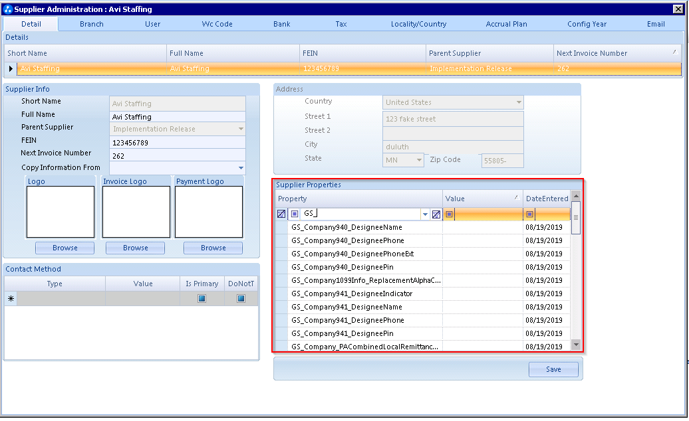
“The employer contact information is incorrect.”
GREENSHADES PROPERTIES IN
ADMIN TOOLS > EMPLOYER > DETAIL
GS_Company_CompanyID = Registration Key!
  Missing info? Contact Account Manager!
GSXMLFeed_Contact_ContactName
GSXMLFeed_Contact_ContactPhone
GSXMLFeed_Contact_ContactPhoneExt
GSXMLFeed_Contact_ContactEmail
Notes:
Employer contact info on the form is incorrect
Admin > employer > search for gs
Any property that start with gs is referencing greenshades – you can edit any of the contact info here and save
Regenerate your feed and xml to see changes
If you’re missing any info in the greenshades properties – contact your Account Manager. It might mean you don’t have our greenshades package and you need it. They can assist you with signing up for Greenshades.

Slide 45
Helpful resources
Notes:
Helpful resources to get you through year-end -

Slide 46




Additional resources
AVIONTÉ UNIVERSITY
Interactive on-demand eLearning.
SUPPORT CENTER
Tickets and guide articles.
WEBINARS
Live virtual training hosted monthly. (NUC)
BOLD BULLETIN
Weekly newsletter.
NOTE: Your account manager is always happy to help. If you have questions, be sure to reach out!
Notes:
Avionte University = Online U
Support Center – Knowledge Base
Webinars – new user courses
Bold Bulletin – weekly newsletter with a variety of information on new features, training schedules, etc

Slide 47




Knowledge Base highlights
ACA DIRECTORY
Links to helpful ACA year-end articles and training modules
TAXES DIRECTORY
Links to articles about W-2 production and distribution, training modules, and Greenshades resources
YEAR-END
Collection of KB articles specifically related to producing year-end reporting in Avionté
ACA SECTION
Collection of all articles related to the Avionté ACA solution
CHECK IT OUT
TAKE A LOOK
LEARN MORE
GET STARTED
Notes:
Helpful KB articles – ACA and Taxes directory help you locate the most useful and thorough year-end related
Posting W2s to the employee/talent portal article available in KB.

Slide 48
Additional training
Year-End Taxes/W-2 Process
Avionté Year-End Taxes/W-2 Process webinars
Recommended for those completing year-end for the first time
Registration Links: Bold Bulletin
Pre-registration is required
Recordings available in the KB
Greenshades Year-End Forms
Hosted By Avionté & our partner Greenshades
For those outsourcing (or considering outsourcing) form distribution to Greenshades
Registration Links: Bold Bulletin
Pre-registration is required
Recordings available in the KB
* All other dedicated training session requests are billable
Notes:
Recording available on KB after webinar.

Slide 49
Q&A
Notes:
Can I generate my feed for Greenshades now and resolve the errors? YES, Absolutely!

Slide 50
Thanks!

