Slide 1
ACA Setup & Tracking

Slide 2
Disclaimer
The information in this webinar is being presented by Avionté as a general informational and educational service to its clients and prospective clients.
This information should not be construed as, and does not constitute, legal advice nor accounting, tax, or other professional advice or services on any specific matter.
Participants should consult with their counsel or other professional advisor before acting on any information contained in this webinar.
Avionté expressly disclaims all liability in respect to actions taken or not taken based on the contents of this webinar.

Slide 3
Agenda
ACA Companion setup
Core Application setup
ACA tracking process
Tracking eligible employees
Date tracking & reporting

Slide 4
ACA Companion Setup

Slide 5
Companion Application Overview
Built with Staffing Industry best practices & reporting requirements in mind!
If you don’t track it, you can’t report on it!
Lookback/measurement method
3-12 month measurement period
Need to determine who is ACA full-time
Not built for monthly measurement!
ACA Reporting compliance
Provides 1095-C forms for:
ACA full-time W-2 employees
W-2 employees enrolled in self-insured coverage
Notes:
Have to select something between 3 – 12 month period → Helps us determine who needs a 1095 at the end of the year
Offer insurance upon hire - Once the ACA Companion is set up, the ACA jobs start running to calculate employee eligibility. This will measure employees and if they are measured as full time, they will have their status changed to Yes.
If you offer right away, then you would have to manually go into the Companion to track offers under employee plan details.
Anyone who enrolls in self-insured coverage – even if not full time – will receive a 1095

Slide 6
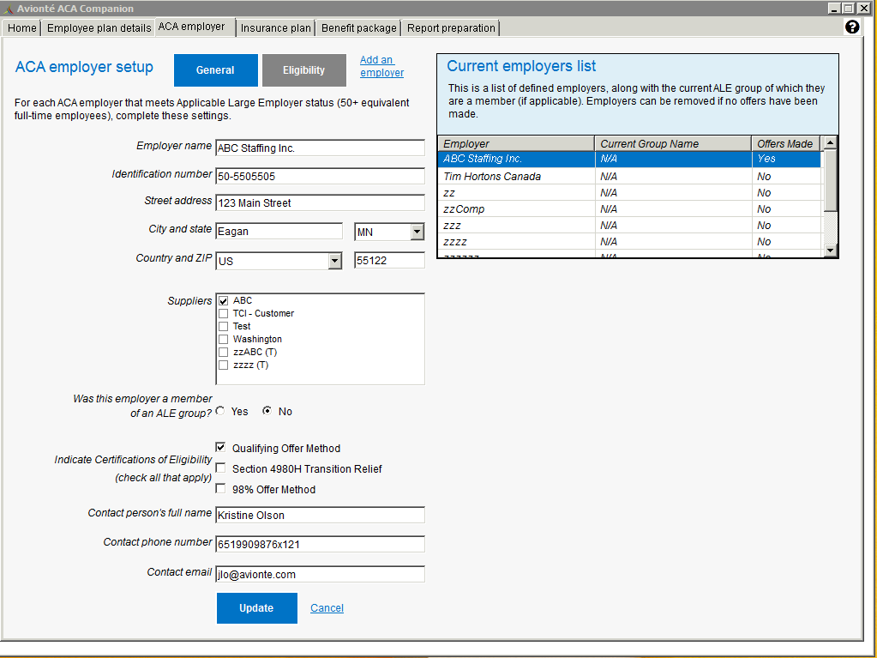
ACA Employer - General
Defines ACA Employer including address, Federal Identification Number (FEIN)
  This information will be pulling in from the Core Application under Admin Tools > Employer > Detail
Collects the information needed for the 1094-C
Notes:
-Employer Name Field: Name of the employer that is the ALE, This should reflect the name of this employer as registered with the IRS.
-Identification Number: The ALE Member’s Federal Employer Identification Number. A 9 digit number including the dash
-Suppliers List: A list of selectable suppliers designated in the core application. Any suppliers associated to an employer in the core application are available for selection here
What is an ALE? *An Applicable Large Employer (ALE) is an employer with an average of at least 50 full-time employees

Slide 7
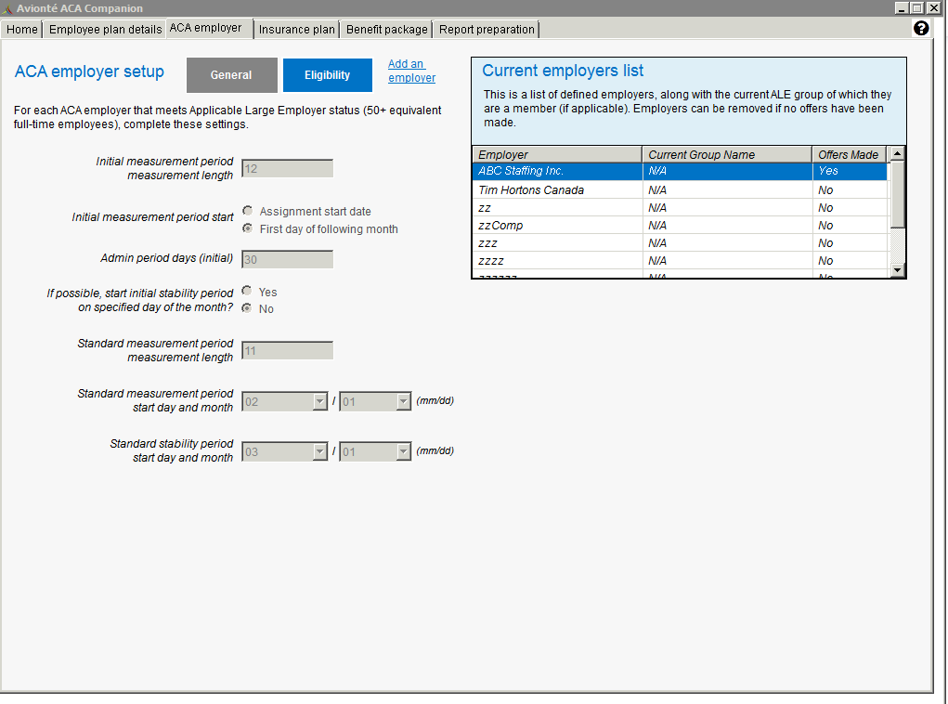
ACA Employer - Eligibility
Defines employers' measurement periods which control when and for how long an employee gets measured for Full Time eligibility status
Notes:
Initial Measurement Period Measurement Length: Enter the number of months that a new-hire’s ACA eligible hours are initially tracked to determine health insurance eligibility. This setting must be between 3-12 months
Initial Measurement Period Start : Select the date on which the Initial Measurement Period will begin
Admin Period Days (Initial): Select the duration (in days) of the employers admin period. This number must be between 0-90 days
Standard Measurement Period Measurement Length: Select the length (in months) of the company’s Standard Measurement Period. This setting must be between 3-12 months
Standard measurement period start day and month: Select the day and the month on which the Standard Measurement Period begins
Standard stability period start day of month: The Standard Stability Period begins on a fixed date each year, select the day and the month this will begin. To determine this date, take the Standard Measurement Period start day of the month setting, add the Standard measurement period measurement length then add the employers Admin Period length
You would need to complete this process for each Employer that will be tracking ACA and producing reporting at year end.

Slide 8
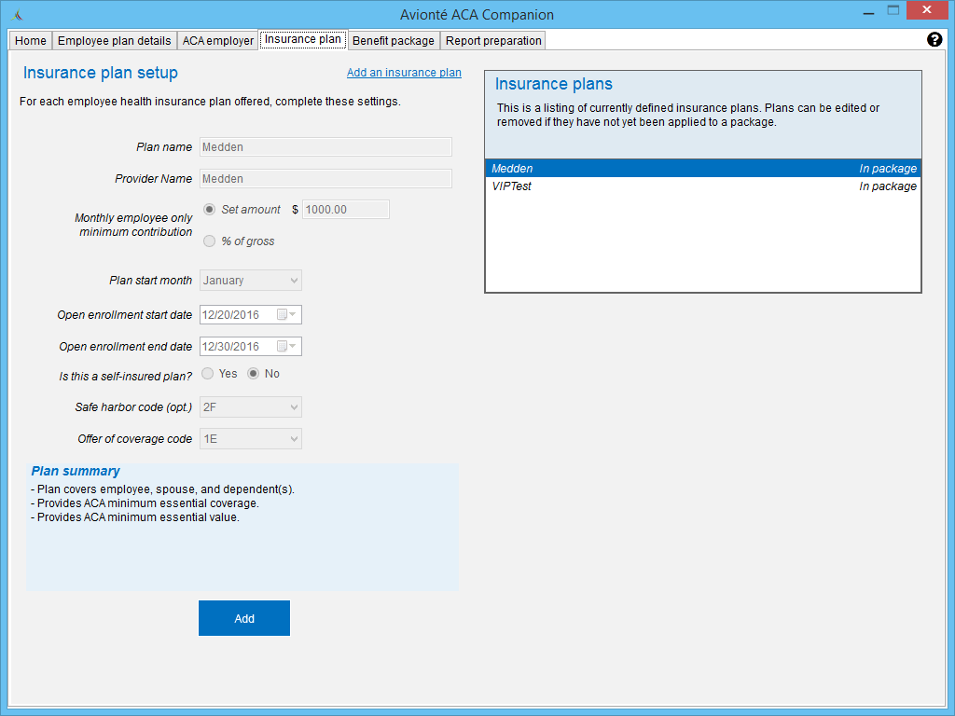
Insurance Plan Setup
Plan and Provider Name
EE Monthly Contribution (Line 15 value)
  What would an employee pay as a monthly premium to cover just themselves?
Plan Start Month
Open Enrollment Dates
Self-insured?
Safe Harbor Code (Line 16, Code Series 2)
Offer of coverage Code (Line 14)
Notes:
Insurance plans need to be added first, then they can be added to benefit packages
Plan Name: Whatever you want, only ever seen by your users (the EE will never see this) We recommend putting the year in the name (i.e. 2022 MEC)
Monthly employee only min. contribution = what is the minimum amount the ee will contribute to pay for the insurance?
Open enrollment dates = doesn’t affect EOY reporting, typically the month before the plan starts
Is this a self-insured plan = important for 1095-C reporting
Offer of coverage code = shows the level of coverage for this plan
As you choose the code, a short description of the plan summary will populate for you to review.

Slide 9
Plans to Set Up
Plans to add
DO not add:
ACA Compliant Healthcare Plans:
Minimum Essential Coverage Plans (MEC)
Minimum Value Plans (MVP)
PPO
Healthcare Plan + HSA
Fixed Indemnity Plans
Non-Healthcare Plans
  Dental
  Vision
  Life
Tiers of Plans (optional)
  EE + Spouse
  EE + Children
Notes:
For 1095-C reporting you only need to report on the employee, not the additional people enrolled

Slide 10
Do I need to set up a new plan?
Yes, if:
New offerings (plan options)
New plans in a package
No longer offering certain plans
Rate changes for Employee Monthly Contribution
Offer of coverage or Safe Harbor Code changes
Notes:
Ask yourself “did anything change from my insurance offering has changed from last year?”
If anything has changed – even just the monthly contribution amount – you will want to set up a new plan

Slide 11
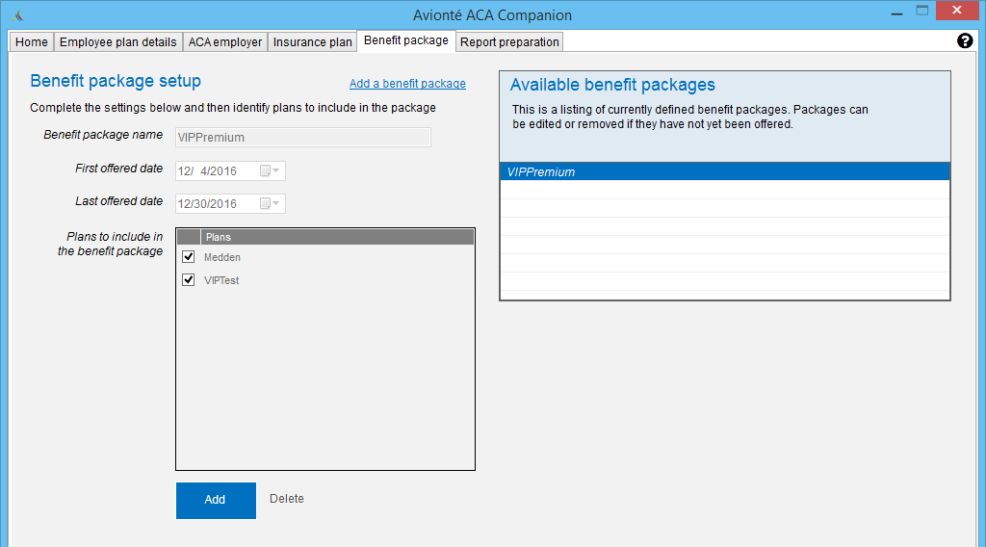
Benefit Package Setup
Benefit Packages comprised of one or more healthcare plans
Healthcare plans can be included in more than one package
Notes:
First and last offered date = typically a year span, different from open enrollment period and usually longer than open enrollment period

Slide 12
Plan & Package Setup Help
Benefit Package
Insurance Plan
Insurance Plan
Insurance Plan
Benefit Package
Insurance Plan
Notes:
If plans are offered at the same time to an EE, bundle those plans under one benefit package

Slide 13
Example
Variable Hours Employees
MEC Plan
Full-Time & Internal Staff
MV Plan

Slide 14
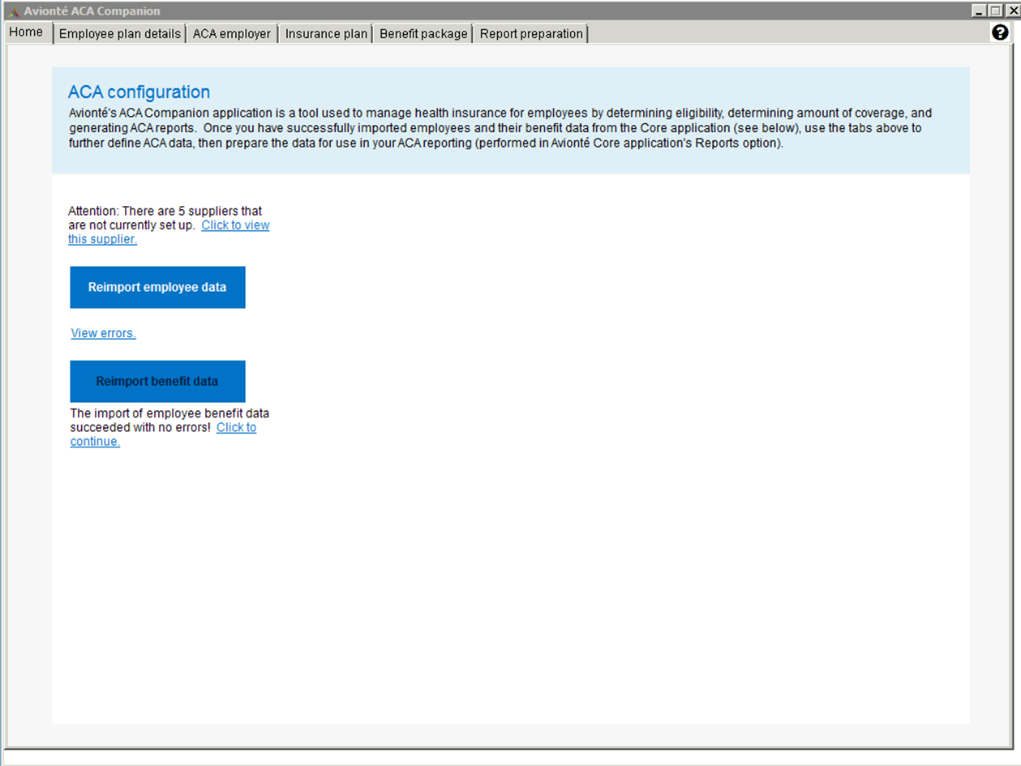
Home
Import Employee Data/Reimport employee data
  Used to import employee data from Avionté database into the ACA Companion
  Employee will pull into the ACA Companion if they have a full name and valid SSN on record
  Will have to manually click the button first time
Import Benefit Data
  Used to import benefit data
  If you are new with Avionté and do not have benefit data you will still need to click this button to finalize
Notes:
First time Companion is set up, you will import employee data – reimport is used for any time after that. You can review errors at any time.
Import benefit data – clicking this finalizes the companion the first time around starting the back end jobs that will run – notice Report prep tab to the far right will be greyed out and no employees hsoe until this step is completed.

Slide 15
Core Application Set Up

Slide 16
Set Up for Core Application Checklist
Who should have access to view ACA Eligibility Data?
Who should have access to edit ACA Eligibility Data?
If you want to enforce the entry of ACA Eligibility status, would you like to do it at assignment creation, during time entry or both?
What pay codes should be counted in ACA measurement tracking?
Who should be alerted with newly eligible employees?
Notes:
Questions to ask yourself…..

Slide 17
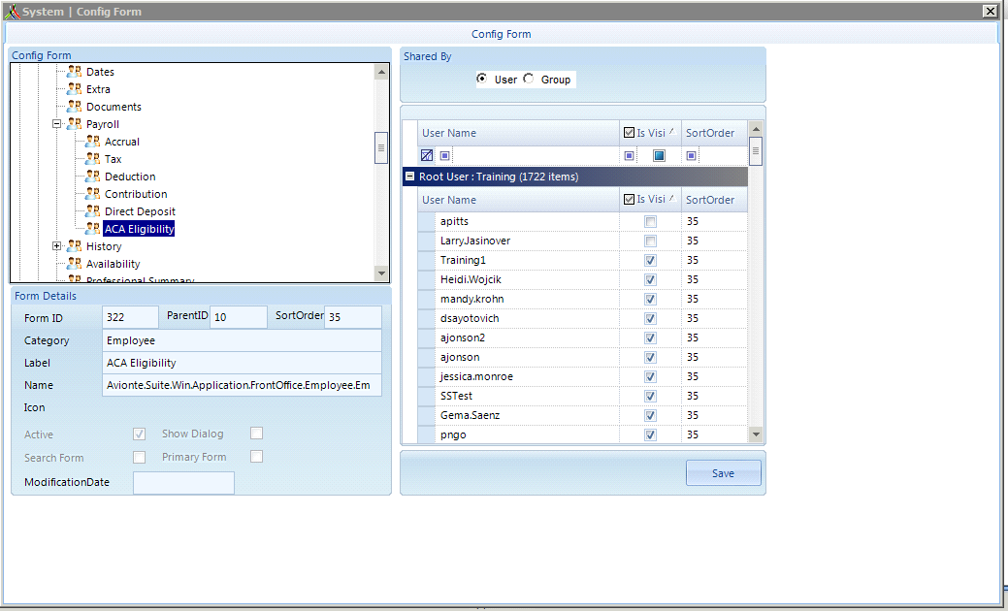
Granting access to view ACA Eligibility data
Admin Tools > Form
  Expand Front Office
  Expand Employee
  Expand Payroll
  Select ACA Eligibility
Can be done on a user-by-user basis
Notes:
This process will allow a user to SEE ACA Eligibility information, not having the ability to change ACA Eligibility
Give access and SAVE.

Slide 18
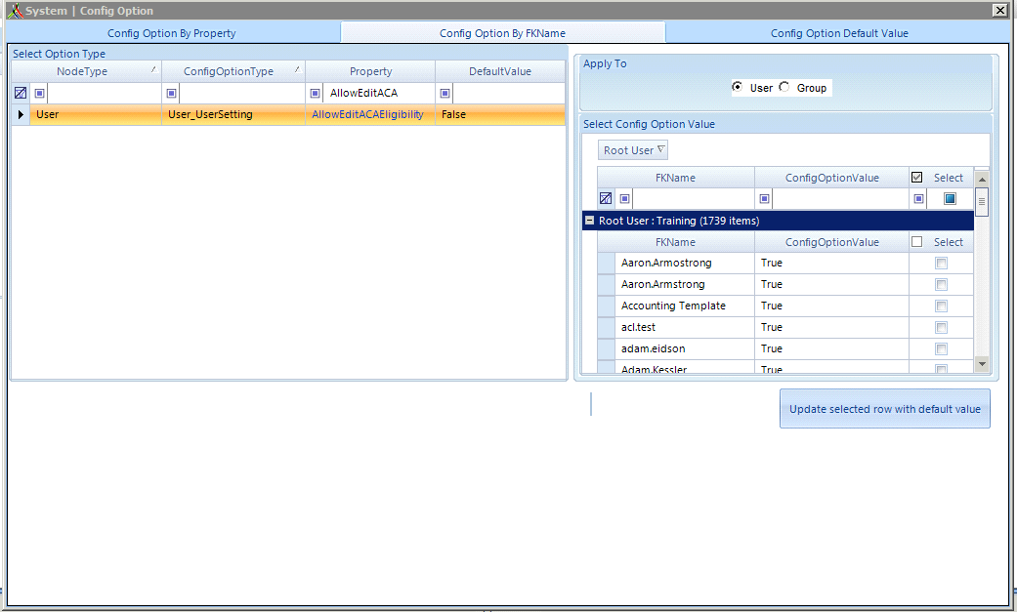
Granting access to edit ACA Eligibility
Admin Tools > Config Option > Config Option By FKName
  Filter the Property column to “AllowEditACAEligibility”
  Select the property
  Change ConfigOptionValue column from False → True
Can be done on a user-by-user basis
Notes:
Gives access to flip that ACA eligibility under Employee record.

Slide 19
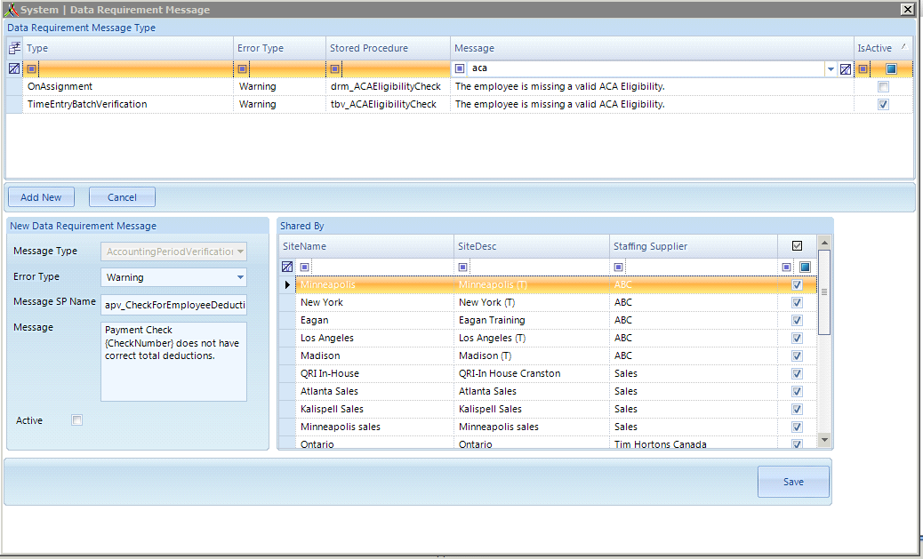
When do you want to be notified of an ACA status not being set?
Admin Tools > Data Requirement Message
Filter Message column to “ACA”
  There should be 2 different options for you
Notes:
There are 3 options for being notified when an employee has an ACA Eligibility status that is not set or selected:
Assignment Creation
Time Entry
Both
If you want to use one or both of these you’ll just want to make sure to check the “Active” box

Slide 20
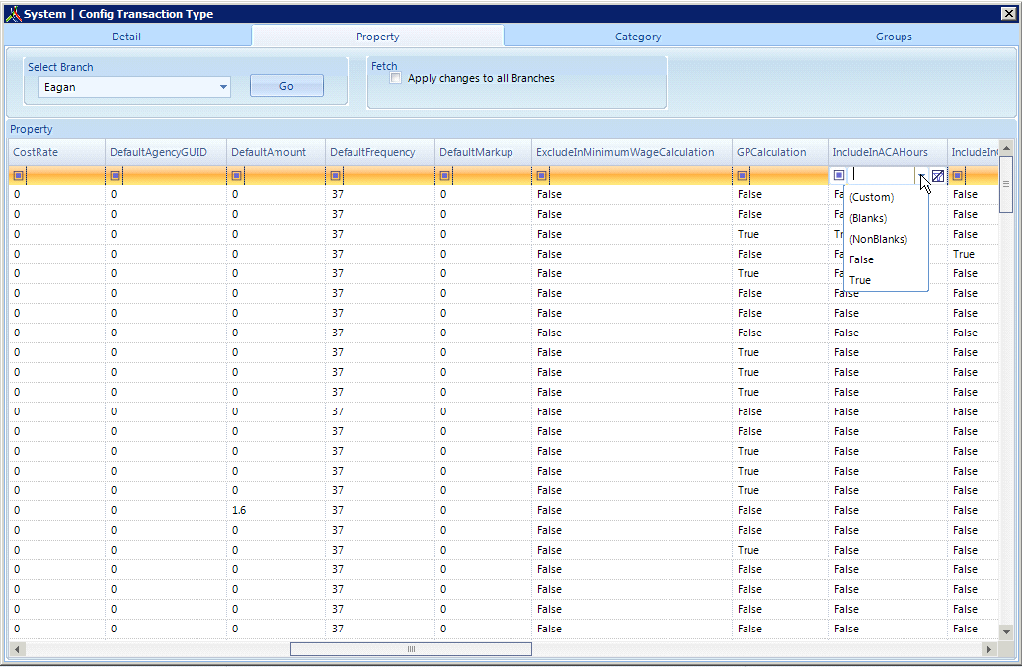
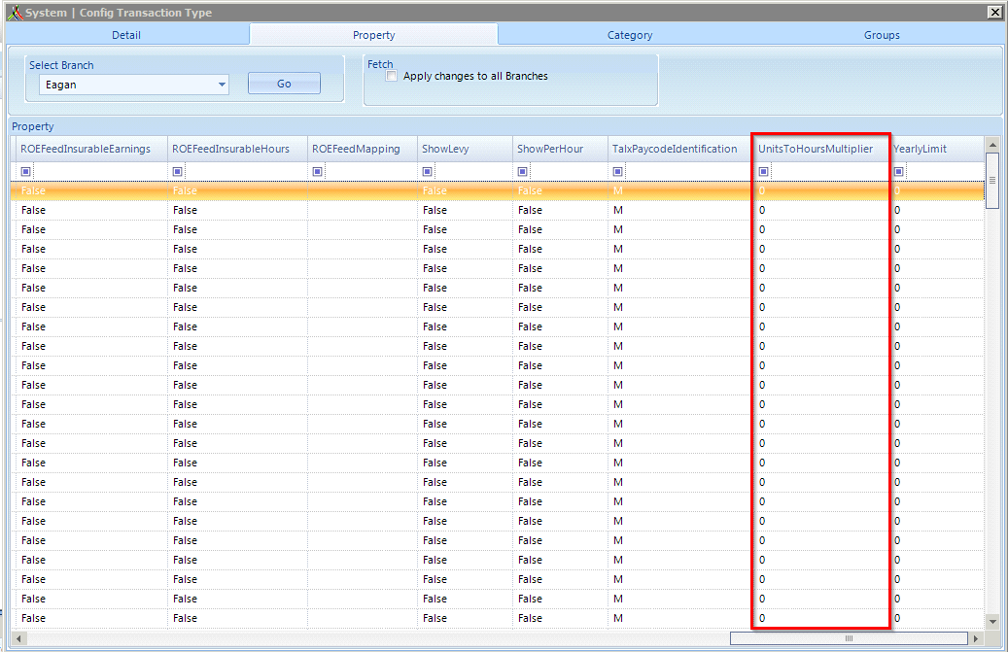
Pay codes to include in ACA tracking
Admin Tools > Transaction Types > Property
  2 columns you will want to verify
    IncludeInACAHours
      When pay codes are used those hours will go towards ACA
    UnitsToHoursMultiplier
      The amount of hours that are actually calculated
  Include in calculation of ACA hours
    Reg, OT, DT, Vac/PTO, Paid FMLA, Sick Time, Paid Military Leave, Bereavement, Employer Paid Disability Time, On Call Time
Notes:
IncludeInACAHours: Can filter your options by what is already preset by using the drop down, if you want to add transaction types to be included in calculating ACA Hours change that value from False → True. If you do not want a transaction type to go towards ACA hours change from True → False
UnitsToHoursMultiplier: This column will depend on how you want hours to be calculated. BEST PRACTICE: Salary paycodes should have a unitstohoursmultiplier of 40 so when you enter in a pay unit of 1 in time entry the system will calculate 40 hours for that salaried employee when that transaction type is used on an order. Reg, OT, DT etc those should be set to 1 so in Time Entry you can enter in the total amount of hours that employee worked and it will calculate the total accordingly. If set to 0 hours will calculate to 0

Slide 21
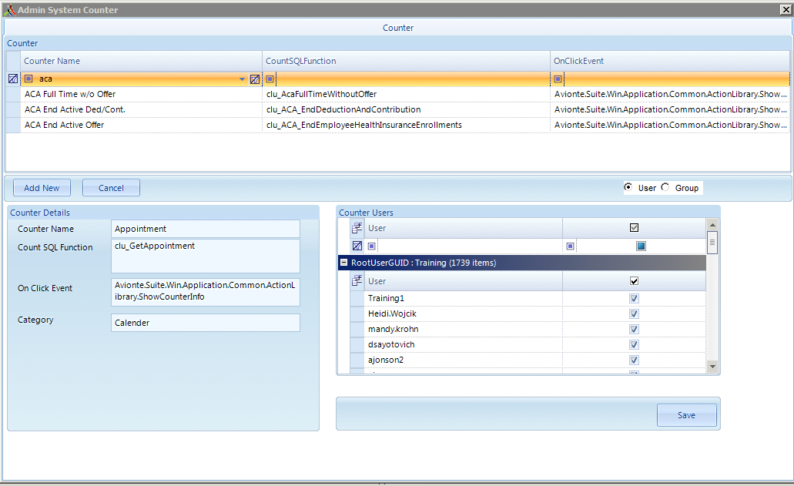
ACA Eligible Counters
Admin Tools > Counter
Permission user based
3 counters available
  ACA Full Time w/o Offer
  ACA End Active Ded/Cont
  ACA End Active Offer
Notes:
Once these are active, Go to Start page and in shortcuts click on View Counterlist and check mark those choose the counters.

Slide 22
ACA Management

Slide 23
Determine Eligibility
Track Eligibility
Record Employee Response
Employee > Payroll > ACA Eligibility
Benefit Package
Benefit Offer Date
Enrollment – Plan choice
Declination – Reason
Make Offer
ACA Counters
ACA Reports
Review & Record
Daily Tracking Process
Reports & AQ’s
Core Application
ACA Companion Application
Both

Slide 24
Determine Eligibility
Track Eligibility
Record Employee Response
Employee > Payroll > ACA Eligibility
Benefit Package
Benefit Offer Date
Enrollment – Plan choice
Declination – Reason
Make Offer
ACA Counters
ACA Reports
Review & Record
Determine Eligibility
Reports & AQ’s
Notes:
Super important because you want to make sure the 1095 is offered to the correct employees

Slide 25
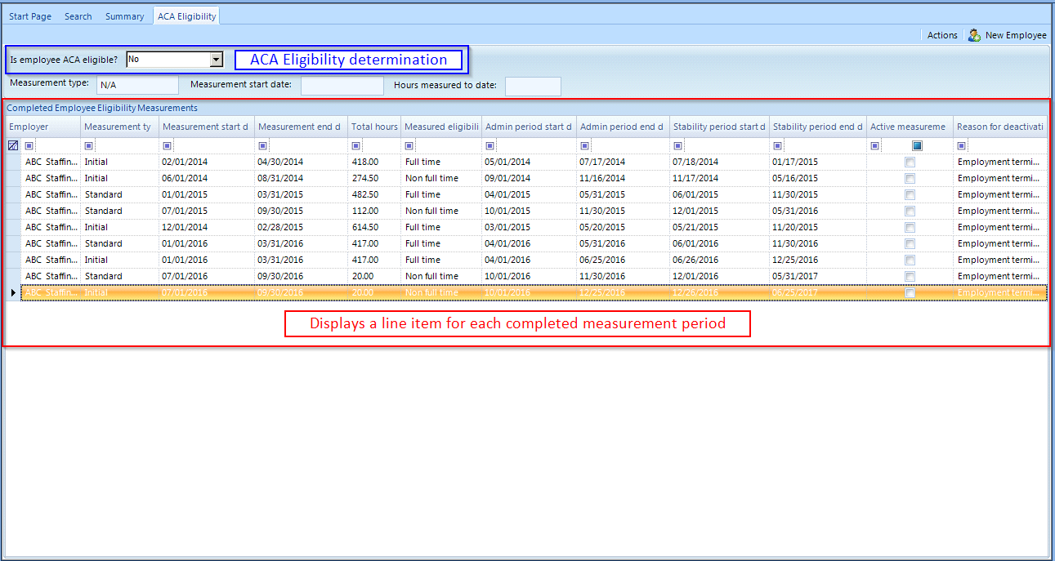
ACA Eligibility Page
Located in Employee > Payroll sub-menu
ACA Determination Status or Eligibility
Measurement Period Data
  Measured Eligibility
Notes:
Dropdown: This is referring to whether the EE is ACA Full Time, not whether or not you offer insurance to the EE
Measurement period is completed when EE hits last day of the period or a qualifying break in service
Can lock down permission to edit the determination
System collects this information for you in the table below and it shows a line item for each completed measurement period

Slide 26
ACA Eligibility Determination Statuses
Yes
Full Time
30+ hours per week
No
Part Time
Variable Hour
Seasonal
Will receive 1095-C*
System will measure to determine eligibility
Undetermined
New employee default
Applicant
Employee reached qualifying break-in-service
*Other conditions must be met - in addition to being set to Yes - for EE to receive 1095-C
Notes:
Best practice is to change dropdown to yes or leave undetermined as soon as they are hired or placed on assignment
If set to No and they hit the ACA full time hours, the system will automatically flip status from no to yes
If set to Yes, a 1095 will be produced for the employee
* Other conditions:
EE W2 Status
EE Paychecks

Slide 27
Determine Eligibility
Track Eligibility
Record Employee Response
Employee > Payroll > ACA Eligibility
Benefit Package
Benefit Offer Date
Enrollment – Plan choice
Declination – Reason
Make Offer
ACA Counters
ACA Reports
Review & Record
Track Eligibility
Reports & AQ’s

Slide 28
ACA Eligible Counters
Name | Description | To Trigger
ACA End Active Ded/Cont. | Displays a list of Employees who do not have any active assignments or future assignments but have active healthcare-related deductions or contributions with no end date. | Up: The count will go up as employee’s assignment ended but still has an active healthcare related deduction or contribution with no end date. Down: The count will go down as the end date is entered to inactivate the deduction or contribution or if the employee is placed on a new assignment.
ACA End Active Offer | Counts any employee who has an ACA eligibility status of “undetermined” and that do not have an open assignment, but they have an active offer (both enrollments and declinations) in the ACA Companion. | Up: The count goes up as an employee has an ACA eligibility status of “undetermined” AND they have no open assignment. Down: The count goes down as an employee has a determined status, or if the active offer is ended in the ACA Companion.
ACA Full Time w/o Offer | Displays the number of full-time employees that are required to be offered an ACA qualified healthcare plan but do not have a current Offer recorded in the ACA Companion. | Up: Will automatically increase if an employee is marked with an ACA Eligibility status of Yes but does not have an offer of insurance in the ACA Companion. Down: Add an active ACA plan offer for the employee in Employee Plan Details of the ACA Companion.
Notes:
3 counters
ACA End Active Deduction/Contribution - Displays a list of Employees who do not have any active assignments or future assignments but have active healthcare-related Deductions or Contributions with no End Date.
2. ACA End Active Offer - Counts any employee who has an ACA eligibility status of "undetermined" and that do not have an open assignment but have an active offer (both enrollments and declinations) in the ACA Companion.
3. ACA Full Time w/o Offer Counter - The counter includes any employee that meets all of the following conditions:
Is active ("ImpliesActive" = true)
Has been designated Full Time either manually or as a result of an ACA measurement period
Has not yet received an offer of ACA benefits in the ACA Companion application
If a counter-eligible employee is found to be terminated based on a gap in employment, the employee will drop off of the counter until they are again found to be eligible.

Slide 29
ACA Reports
ACA Companion Census AQ:
Shows an employee’s total hours and ACA Eligibility as well as total wages, benefits and benefit amounts
ACA Companion Insurance Offers AQ:
Displays a list of all offers made in the ACA Companion Application
ACA Companion Employee Sync Error AQ:
Shows a list of employees who did not import into the ACA Companion
Displays why an employee did not import and what needs to changed
Needs to be followed by an import to update the employee records
1095 C & 1094 C Report:
Employer-Provided Health Insurance Offer and Coverage Insurance Form
Required to be distributed to employees of an ALE member who is full-time for one or more months during the calendar year
Grant permission to view these reports in Admin Tools > Report
  If report cannot be located in Admin Tools, input ticket to Support Center to deploy
These are all reports and AQ’s that should be run on a regular basis
Notes:
Basically shows the EEs who are ACA Full time who have not yet been made an offer

Slide 30
Determine Eligibility
Track Eligibility
Record Employee Response
Employee > Payroll > ACA Eligibility
Benefit Package
Benefit Offer Date
Enrollment – Plan choice
Declination – Reason
Make Offer
ACA Counters
ACA Reports
Review & Record
Making/Tracking Insurance Offers
Reports & AQ’s

Slide 31
Tracking Coverage Offers

Slide 32
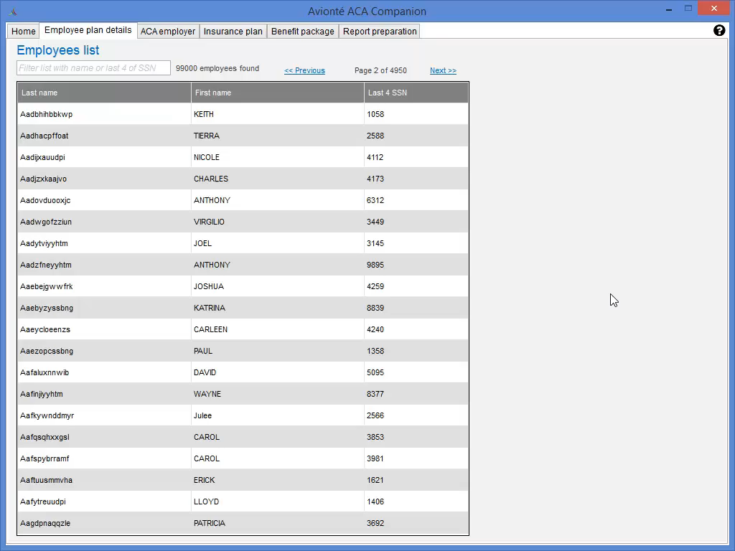
Notes:
Navigate to “Employee Plan Details” tab to search for an employee to make your offer of coverage
You will see a searchable grid, you can search for an employee by entering in their name or last 4 of SSN
Once you find your employee, double click on their name

Slide 33
What if I can’t find my employee in the Companion Application?
Run the ACA Companion Employee Sync Errors AQ!
Individual Manual Fixes
Mass Fixes
Make fixes in core application
  Name
  SSN
  Primary Address
Reimport Employee Data
  Companion App > Home
Run ACA Companion Employee Sync Error AQ in Reports
  Displays Name, SSN, Address, Last Check Date
Export AQ to Excel
  Make edits to employee information
Import spreadsheet via Import/Export main menu
Reimport Employee Data
  Companion App > Home
Notes:
Companion automatically syncs in all EE records with a first and last name, full SSN, and primary address
Duplicate EE records will also hold back EEs from pulling into Companion if information does not match
Some work up front when you first begin to use Companion but then it is something you can complete on an ongoing basis

Slide 34
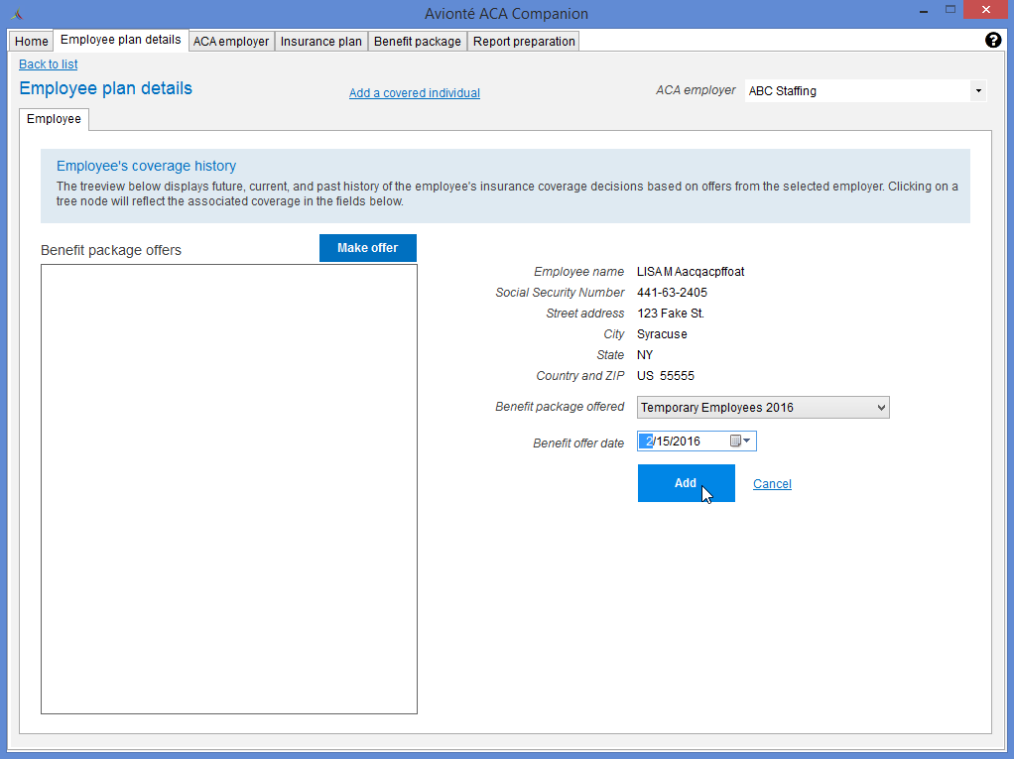
Employee Plan Details
Select ACA Employer in top right corner
Select “Make Offer”
  Select Benefit Package
  Benefit Offer Date = Date employer sent offer
  Click Add
Notes:
This is the place you use the most after the setup has been completed
Remember to choose your specific employer from the drop down (if more than one)

Slide 35
Determine Eligibility
Track Eligibility
Record Employee Response
Employee > Payroll > ACA Eligibility
Benefit Package
Benefit Offer Date
Enrollment – Plan choice
Declination – Reason
Review & Record
Make Offer
ACA Full Time without Offer Counter
ACA Companion Census AQ
Reports & AQs
Recording Enrollments or Declinations
Notes:
Once you make the offer the EE will fall off the “Full Time w/o Offer” counter

Slide 36
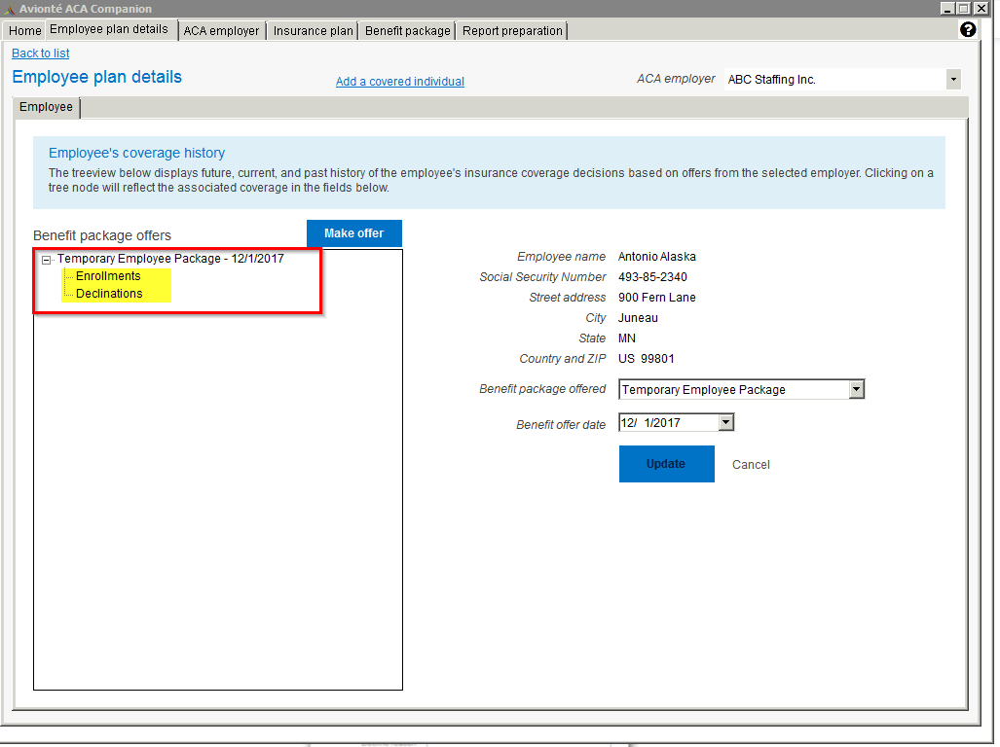
Employee Plan Details (continued)
Single click on Enrollment or Declination from the tree to insert employee response
Notes:
Once you select “Add” for your offer of coverage, you will see that offer under your “Benefit Package Offers” box where then you can select if an employee enrolled or declined

Slide 37
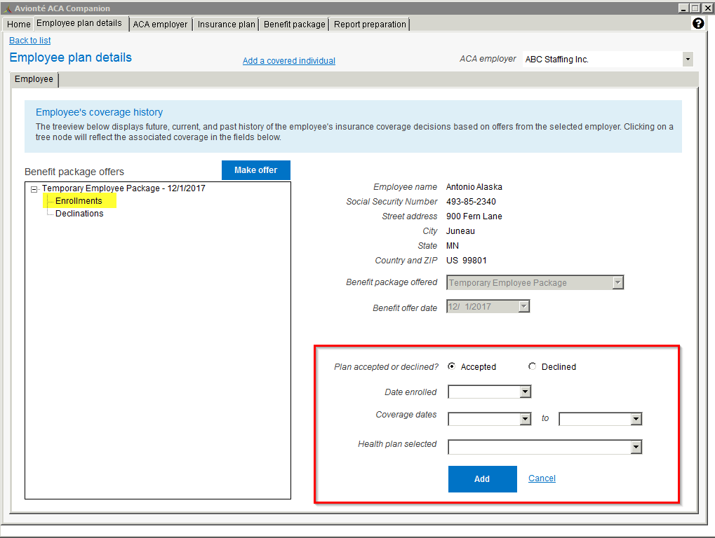
Employee Plan Details (Enrolled)
If employee enrolled, single click on “Enrollments” and enrollment box will populate
Notes:
Date Enrolled = date the EE said they want to take the offer
Coverage Dates = Super Important! Directly affect 1095 C
Start Date = the date they were covered with insurance
End Date = can leave open, or put in the end date for the plan itself. If EE terminates mid-year, make sure to input that date as the end date

Slide 38
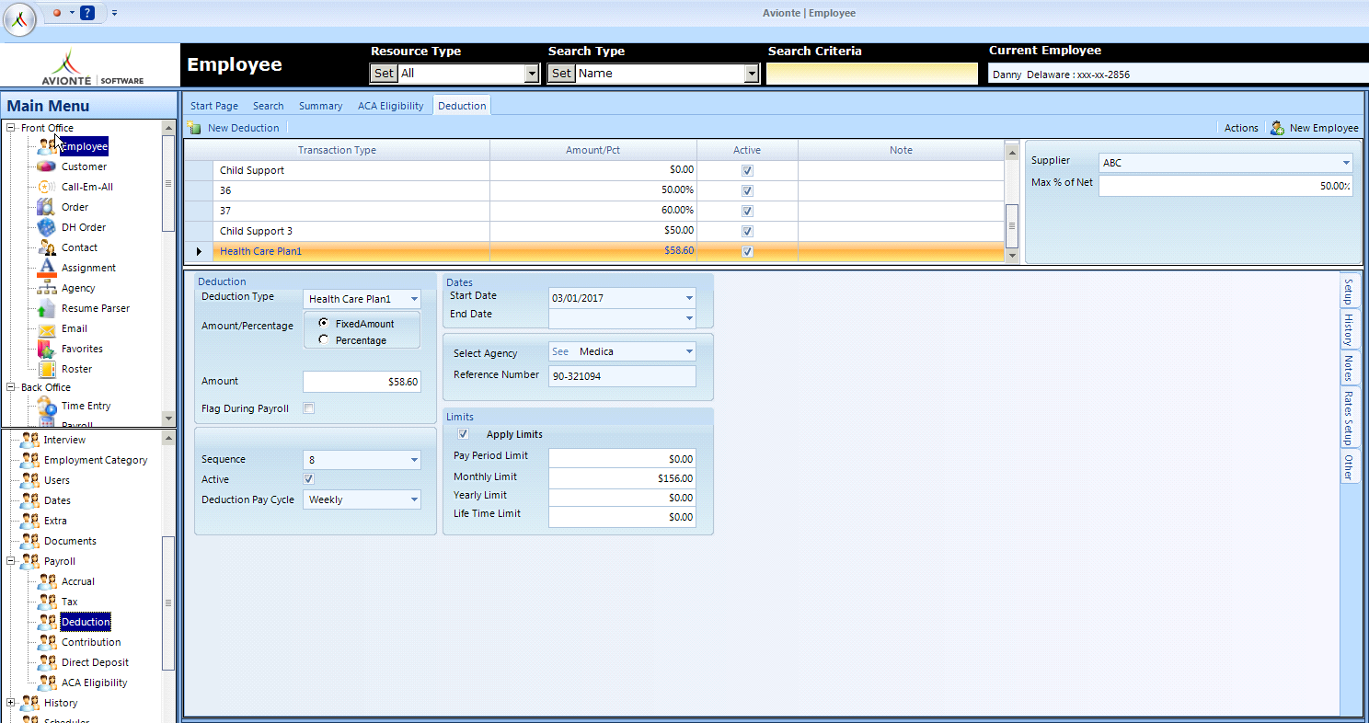
Payroll Deductions & Contributions
Add Deductions or Contributions in core application for payroll purposes if employee enrolls
  Employee > Payroll
Notes:
Does not affect 1095 report
For those using the Essential Staffcare integration, completing your weekly imports will populate these deductions

Slide 39
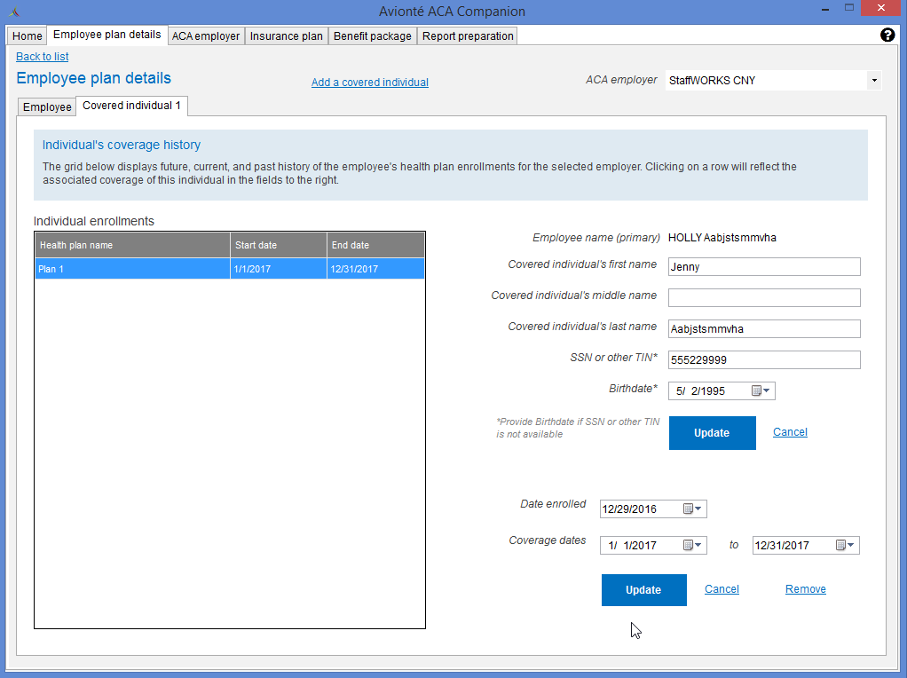
Covered Individuals
Need to track if self-insured!
Spouses & Dependents
Need SSN and/or DOB
Enter Date Enrolled
Enter Dates of Coverage (can differ from Employee’s)
ABC Staffing
Notes:
Collect the covered individual’s name and birthdate or SSN – usually get from insurance company
Dependent information is not tracked in Avionte!
Coverage Dates = when they actually had insurance through this plan, could be different than the coverage dates for the EE
Shows which months the person was covered on 1095

Slide 40
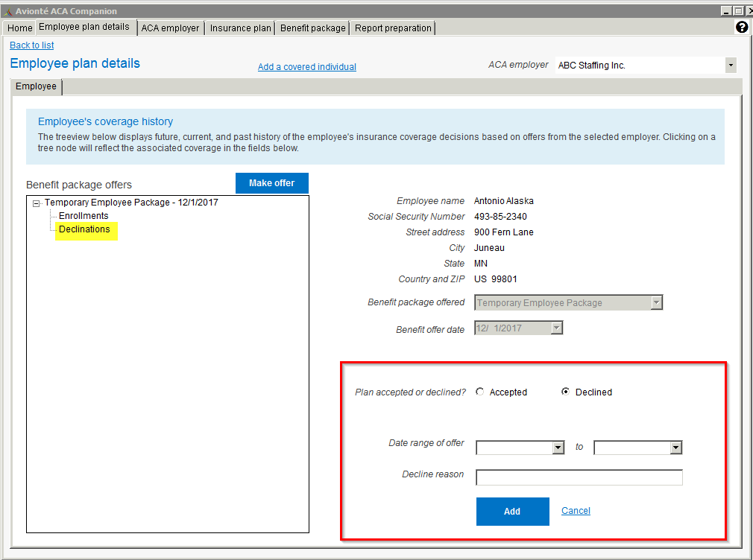
Employee Plan Details (Declined)
If employee Declines, single click on “Declinations” and declination box will populate
Notes:
Date range of offer: The range of dates in which the employee was eligible for insurance and able to accept or decline the insurance plan offer
End date should be left blank if they are still currently declining
Decline reason field: A free text field used to describe why the employee declined the insurance plan offer
Click “Add” once declination is completed

Slide 41
Date Tracking Explained!
Date Field | Use/Purpose
Benefit Offer Date | Date Employer sends offer to the Employee
Date Enrolled/Declined | Date Employee responds to offer of coverage
Coverage Dates | *Controls date range that offer and enrollment is shown on the 1095-C*
Deduction/Contribution Dates (Core application) | Controls when the deduction or contribution is affecting the paycheck. The start date needs to be within the Week Worked to pull onto the paycheck.

Slide 42
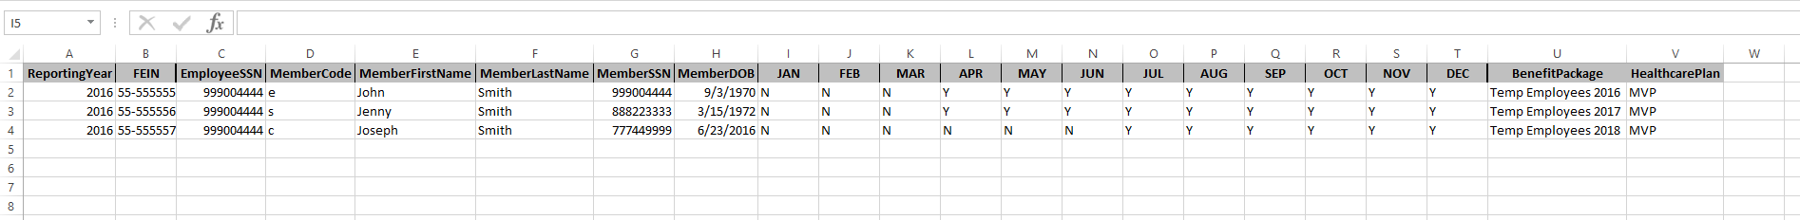
ACA Import
The ACA Import is designed to insert mass enrollments into your ACA Companion Application rather than manually inserting these items
Article: https://support.avionte.com/hc/en-us/articles/235826327-Core-Application-ACA-Import-and-Export
Notes:
A spreadsheet template is available for download at the bottom of the ACA Import article. The spreadsheet can be used to insert insurance offers and their corresponding declinations and enrollments straight into the Companion application.

Slide 43
Declination Export
You can do your own mass declination inserts into the ACA Companion
Name: ACA Companion Declination Export
  This is an AQ that can be found under “Reports”
This should be done at the end of the year
  All enrollments will need to be entered into the ACA Companion prior
  Employees will pull once you “Generate Data” for that year and they have a 1H on line 14 of the 1095-C, with any line 16 code that wasn't 2A, 2B, or 2D
  Will be using the “ACA Import” to import the declinations into the ACA Companion
Video: https://ilos.video/MrZLHV
Knowledge Base Article: https://support.avionte.com/hc/en-us/articles/360001609608-ACA-Companion-Declination-Export-AQ

Slide 44
Determine Eligibility
Track Eligibility
Record Employee Answer
Employee > Payroll > ACA Eligibility
Benefit Package
Benefit Offer Date
Enrollment – Plan choice
Declination – Reason
Review & Audit
Make Offer
ACA Counters
ACA Reports
Reports & AQs
Review and Audit Data

Slide 45
ACA Companion related AQs
ACA Companion Census AQ
Review eligibility, measurement, and offer data from the companion
ACA Companion Insurance Offers
Audit offers, enrollments, and declinations entered in the Companion Application
Should not be used to track people who SHOULD need offers
Grant permission to view these AQs in Admin Tools > Report
If report cannot be located in Admin Tools, input ticket to Support Center to deploy
Notes:
Insurance Offer AQ: Shows data that’s been entered in, not the data that hasn’t been.

Slide 46
Sync Error AQs
ACA Companion Employee Sync Errors AQ
Gives details of employees related to syncing of their Name or address.
ACA Companion Employee Sync SSN Errors AQ
Gives details of employees with sync errors related to SSN
Use parameters of “Has paycheck” using 4-digit year
Usually, invalid SSN
ACA Companion Employee Primary Address Error AQ
  Gives details of errors on the Employee’s address.
Notes:
Sync AQs should be run on a regular basis. Shows you any corrections that need to be made before year –end

Slide 47
Coverage Date Management
Terminated employees should have their coverage end date updated in the ACA Companion!
Audit via the ACA Companion Census AQ
  Recent Check Date
  Assignment End Date
  Can compare to ACA Companion Insurance Offers AQ or to the Companion Application
Create processes internally for terminating an employee
Make sure to end offers and deductions/contributions for healthcare

Slide 48
Additional Resources
Avionté Support Center
  support.avionte.com
  Access through AVI (Avionté Virtual Instructor) in BOLD
  Knowledge Base – fully updated articles on ACA Companion
  Ticket input
Bold Bulletin
  Compliance webinars
  Webinar Library

Slide 49
Questions?

Slide 50
Thank you for watching!

