Slide 1
HOW IS THE HEALTH OF YOUR CURRENT ACA PROCESS?
Notes:
Welcome to the 2022 How is the Health of your current ACA process. We appreciate you taking the time to prepare your company for success with your 1095-C year end filings.
A few housekeeping items before we get started:
All attendees are in listen-only mode to reduce background noise
If you have any questions, please use the Q/A box
This webinar is being recorded and will be available in the KB along with the powerpoint for your reference as you work through year-end.

Slide 2
Agenda
WE’RE GOING TO COVER…
1
Why start now?
4
Helpful resources
2
Creating a plan
5
Q&A
3
Taking action
Notes:
Here’s what we are going to cover today…..

Slide 3



It’s nice to meet you!
BECKY FOX
SR. PRODUCT TRAINER
Notes:
Been with Avionte for 8.5 YEARS– 13 plus years in staffing – experience on both sides of Avionte.
Worked specifically with year-end team for years.

Slide 4
Disclaimer
The information in this webinar is being presented by Avionté as a general informational and educational service to its clients and prospective clients.
This information should not be construed as, and does not constitute, legal advice nor accounting, tax, or other professional advice or services on any specific matter.
Participants should consult with their counsel or other professional advisor before acting on any information contained in this webinar.
Avionté expressly disclaims all liability in respect to actions taken or not taken based on the contents of this webinar.
Notes:
This disclaimer will specify the scope of what Avionte can do for you in the year-end process.
Can not stress enough that you need to consult with legal or tax decisions that concern your business.

Slide 5
Why now?
Notes:
Things you should do now to make January and the creation of 1095-Cs a smooth process

Slide 6
Important dates:
JANUARY 31
1095-C forms delivered to employees (proposed automatic extension to March 2)
State filing mandates for CA, DC, NJ, MA, RI (due dates vary)
FEBRUARY 28
Paper filing of 1094-C with IRS*
MARCH 31
Electronic filing of 1094-C with IRS
JANUARY 2023
SUN | MON | TUE | WED | THU | FRI | SAT
1 | 2 | 3 | 4 | 5 | 6 | 7
8 | 9 | 10 | 11 | 12 | 13 | 14
15 | 16 | 17 | 18 | 19 | 20 | 21
22 | 23 | 24 | 25 | 26 | 27 | 28
29 | 30 | 31
Notes:
**** Great news*****New proposal by the IRS: after initially saying there would be no automatic deadline extension for delivering Affordable Care Act (ACA) 1095 reporting forms to employees at the start of 2022, IRS has now proposed a permanent, automatic 30-day extension, until March 2, for furnishing employee forms. The proposal says employers and insurers may take advantage of the extension for 2021 reporting forms before the rule is finalized. The proposal does not change the due dates for filing these forms with the IRS.
*Employers that file 250 or more returns with the IRS must file the returns electronically.

Slide 7

Expectations
ENSURE SUCCESS BY…
Review current insurance and benefit plans
Resolve any sync errors or missing employee data
Gather consent for electronic 1095-Cs
Identify internal ACA resource(s)
Notes:
We want to set you up for success and the way to do that is preparation. Defn of preparation states “something done to get ready for an event or undertaking.”
Well, year end for those of you who work in the back office can be an undertaking…… a little year end humor for my back office folks!

Slide 8
Create a plan
Notes:
Things you should do now to make January and the creation of 1095-Cs a smooth process

Slide 9
Quick check
BEFORE YOU GET STARTED…
Must use Avionté as your Back Office & process payroll
Must be on Greenshades Basic Package with Avionté
Allows you to pass XML file to Greenshades for annual filings
Must have ACA package and set up ACA Companion Application
Must be properly tracking data in your system
Notes:
A few quick items to check first before you get started.
1– Have to use BO (whether Classic or Bold) to track the info needed for the ACA process – looking at the transactional data
2 - If you do not yet have Greenshades, you can chat with AM/AD to get signed up. There is paperwork that needs to be completed to get a registration key for the integration.
3 – ACA package and ACA application are set up using the info provided in the ACA workbook provided during set up.
4 – Must be tracking data in your system – that means ending assignments in a timely fashion, putting in offers and declines, accurately updating insurance, etc.

Slide 10
Preparation = Success
What can I do now…
Organize your internal ACA team
Review what worked well? What were the challenges?
Gather resources and address any knowledge gaps or challenges
Start data review and audit early
Notes:
As a member of our Training Team and year-end teams, I know firsthand the demands of January and the dramatic increase of calls and tickets that result from your tax filing and ACA obligations. One of our key objectives today is to share with you ways to ensure accurate 1095-C filings and have confidence in your data going into January and February.
We know that preparation is key to a successful and stress-free January so let’s cover some suggestions on how to create a plan for tackling the increased workload in January.
1 – Organize a year-end team: There is a considerable work required in January that impacts multiple teams. Payroll will be processing the last payrolls of the year and ensuring all paycheck adjustments and corrections are completed. HR is working to ensure new benefits are set up by Jan 1 and all compliance changes in place. Finance is often very busy closing out the quarter and fiscal year. Bringing these teams together is important to ensure alignment on timeline and responsibilities. Coordination is key…. Just like we coordinate our wardrobe….
2 – Then, as a group, reflect on lessons learned from last year-end. What went well that we want to repeat? What areas presented us challenges and what do we need to do to make sure we don’t struggle with the same issues this year?
3 – To address those challenges, learn what resources are available. In addition to software and data issues, am I aware of changes for this next year? Are there resources like the American Payroll Association, legal blogs, or HR resources like SHRM that may have information I need?
4 – Most importantly, start early. Reviewing data now will save you time in January. 1095-C will be updated in Avionte once the IRS releases the final version of the form next month (Oct 14th)

Slide 11
Take action
Notes:
Let’s talk about what actions to take

Slide 12
Determine Eligibility
Track Eligibility
Record Employee Response
Employee > Payroll > ACA Eligibility
Benefit Package
Benefit Offer Date
Enrollment – Plan choice
Declination – Reason
Make Offer
ACA Counters
ACA Reports
Review & Record
Daily Tracking Process
Reports & AQ’s
Core Application
ACA Companion Application
Both
Notes:
One of the biggest challenges our clients face at the end of the year is that data needed for ACA reporting is not being entered, which is why it is important to review processes now to ensure we are populating the data in the system that leads to accurate 1095-Cs.
As a reminder, you should be following this daily tracking process throughout the year in order to produce accurate employee 1095-Cs. As we know, we must run payroll for employees every week in order to produce accurate W-2s at the end of the year. Similarly, we must create a weekly tracking practice for the system to create 1095-Cs at the end of the year.
(Daily tracking process)
Daily or weekly tracking of employee healthcare coverage
By this time, you should have set-up your aca companion and been recording and making offers to employees as well as whether they enrolled or declined
Determining eligibility upon assignment; telling the system if they’re ACA fulltime or variable hours
Tracking eligibility ongoing, for example if they hit full time hours by the end of your measurement period – you want to make sure you’re offering insurance at that time
You want to make sure you’re making offers and recording that within the ACA companion
Recording the employee response
If you decline and the reason
If they enroll and what plan
ACA Reports that help track this in the report section
If you haven’t been doing this, no worries, at the end of the webinar, I will show you how you can get the forms generated via an import

Slide 13
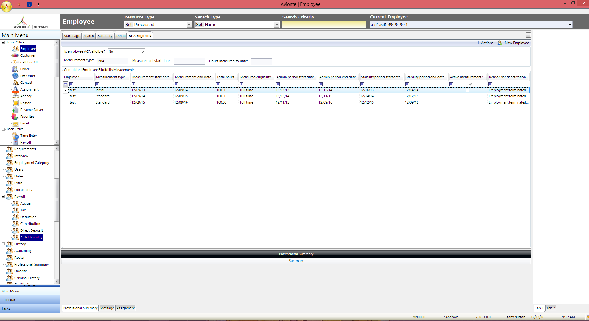
ACA Eligibility
ACA Eligibility Dropdown – refers to whether or not an employee is ACA Full Time, not if you offered insurance
ACA only requires forms for people who are ACA Full Time or enrolled in a self-insured plan.
Best practice, make determination on assignment.
By default, all new employees are undetermined.
Notes:
the ACA Eligibility is so important because the system needs to know who the full time employees are for ACA. These employees require a 1095-C and there are 2 ways for that Avionte allows determination of status. First, is you can tell the system that the employee is full time on the ACA Eligibility page
The ACA Eligibility screen in the core application (found in Employee > Payroll sub-menu). ACA eligibility, and whether the employee is ACA full time is one of the key factors on if the employee needs a 1095-C form.
As a reminder the ACA eligibility screen in the core application has an important field called the eligibility dropdown
Before we talk about the process, I just want to remind you about this dropdown
You can find this under employee > payroll > aca eligibility
IF YOU DO NOT SEE THIS IN YOUR SUB MENU ITEMS, YOU CAN HAVE YOUR ADMIN GO INTO ADMIN TOOLS > FORM TO MAKE IT VISIBLE FOR YOU.
As a best practice – make this determination upon assignment
By default, all new employees are undetermined
Should be setting this to no if they are variable hour
Yes if they are going to be working aca full time hours
If you select yes – those are people who get a 1095-C
This isn’t asking if are going to be offering an employee insurance, you can offer to anyone
This triggers those who are aca full time and need a 1095-C
ACA only requires forms for people who are aca full time or enrolled in a self-insured plan – so if you set yes on this dropdown for everyone you might be printing 1095-Cs you don’t need
*****Mark yes or leave as undetermined.

Slide 14
ACA Eligibility
CLASSIC > Employee > Payroll > ACA Eligibility
Eligibility will auto-change to:
    Yes - Employee reaches end of measurement period and meets or exceeds full time hours requirement
    No – Employee reaches end of measurement period and does not meet hours requirement
    Undetermined – Employee hits break in service
      (e.g. 13 weeks with no ACA hours; also rules of parity)
YES
Undetermined
NO
Notes:
The ACA Eligibility screen in the core application (found in Employee > Payroll sub-menu). ACA eligibility, and whether the employee is ACA full time is one of the key factors on if the employee needs a 1095-C form.
By default, all new employees are undetermined
Should be setting this to no if they are variable hour
Yes if they are going to be working aca full time hours
If you select yes – those are people who get a 1095-C
*****Mark yes or leave as undetermined.
Rule of parity for ACA - an exception that employers can leverage for not having to reoffer coverage to applicable employees who leave and return to work over a short window of time
If the last period of employment period is equal to or greater than the break in ACA hours then it is NOT considered a break in service and should continue with the standard measurement period.

Slide 15
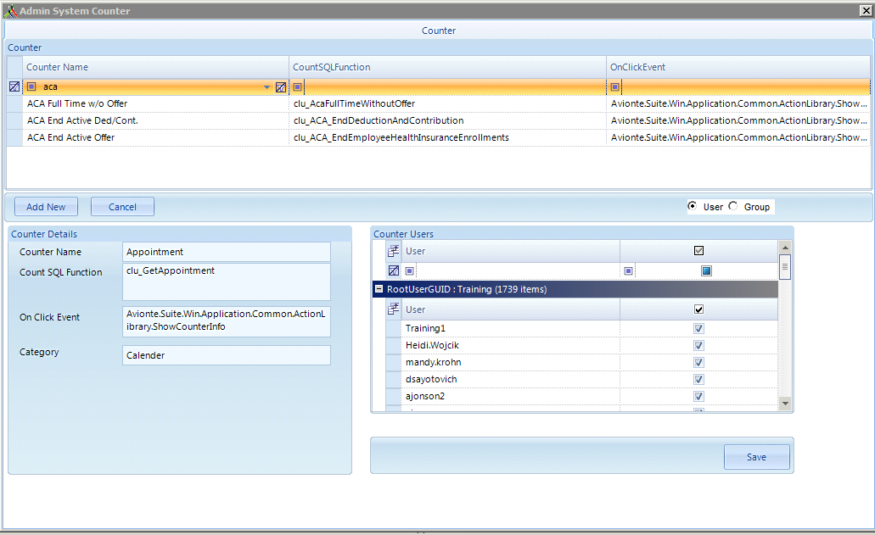
Monitor ACA Eligible Counters
Admin Tools > Counter
Permission user based
3 counters available
  ACA Full Time w/o Offer
  ACA End Active Ded/Cont
  ACA End Active Offer
Notes:
Once these are active, Go to Start page and in shortcuts click on View Counterlist and check mark those choose the counters.
Monitor ACA Full Time W/O Offer counter for those employees needing an insurance offer – done weekly

Slide 16
Insurance Plans and Benefit Packages
Notes:
Let’s talk about the Aca Reporting

Slide 17
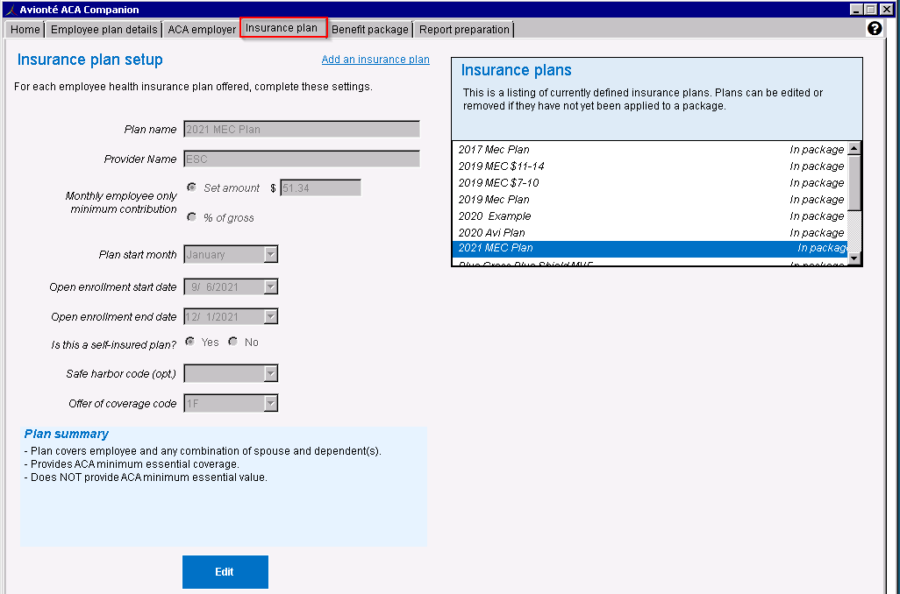
Add or Update Insurance Plans
Setting up Insurance Plans:
Plan and Provider Name
EE Monthly Contribution (Line 15 value)
Plan Start Month
Open Enrollment Dates
Self-insured?
Safe Harbor Code (Line 16, Code Series 2)
Offer of coverage Code (Line 14)
Adding a New Health Insurance Plan
Notes:
Before I can document that I offered any employees insurance, I need to ensure the insurance plan and benefit package set up is completed for this year. If I haven’t already created my 2022 insurance plans, I should do so now, before I test the 1095-Cs in November and December.
In ACA Companion – Insurance plan tab
Insurance plans need to be added first, then they can be added to benefit packages
As part of the set up, I need to enter in a name for the plan as well as the provider. Both are for internal reference only, they will not print on the 1095-C.
The key fields that impact the 1095-C are the cost of the plan, the plan start month, if the plan was self-insured and the applicable codes for Lines 14 and 16 of the form. Those fields, in the boxes shown, will all pull onto the 1095-C.
Plan Name: Whatever you want, only ever seen by your users (the EE will never see this) We recommend putting the year in the name (i.e. 2022 MEC)
Monthly employee only min. contribution = what is the minimum amount the ee will contribute to pay for the insurance?
Open enrollment dates = doesn’t affect EOY reporting, typically the month before the plan starts
Is this a self-insured plan = important for 1095-C reporting
Offer of coverage code = shows the level of coverage for this plan
DO I need to change my insurance plans or benefits each year?? YES!
May have added new offerings or removed some, new plans in a package, rate for employees may have changed ($), offer of coverage for Safe Harbor may have changed (addition of new codes)
Link to article on how to do this is in the KB.

Slide 18
Insurance Plans
Plans to Add
ACA Compliant Healthcare Plans:
  Minimal Essential Coverage Plans (MEC)
  Minimum Value Plans (MVP)
  PPO
  Healthcare Plan + HSA
Do not add
Fixed Indemnity Plans
Non-Healthcare Plans
  Dental
  Vision
  Life
Tiers of Plans (optional)
  EE + Spouse
  EE + Children
Notes:
When you are setting up your plans, here is a guide to use….

Slide 19
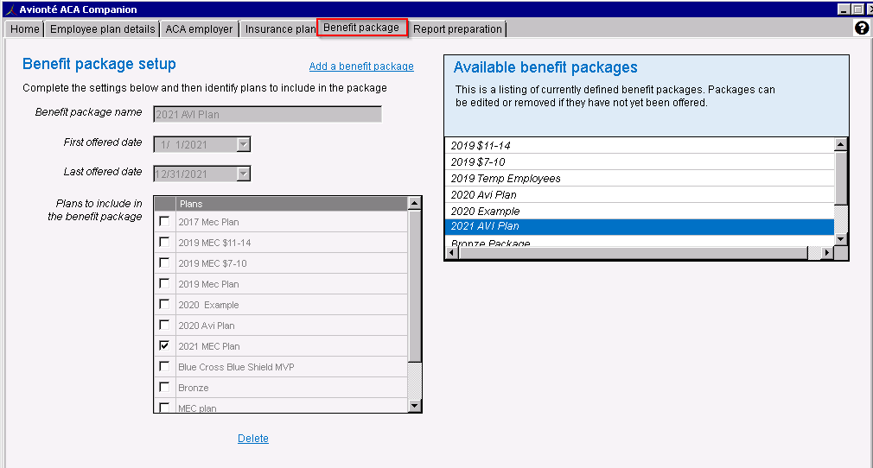
Add or Update Benefit Packages
Setting up Benefit Plans:
Benefit Packages comprised of one or more healthcare plans
Healthcare plans can be included in more than one package
External vs Internal employees
Plans offered at the same time to an employee, bundle plans under one benefit package
Notes:
Completed after you have entered in Insurance Plans
Use Years in name for tracking
Choices you offered to your employee – tracking for line 14, 15 and 16
First and last offered date = typically a year span, different from open enrollment period and usually longer than open enrollment period
May have offered different plans to external (temp) then internal employees – can identify that when setting up the plans

Slide 20
Tracking Coverage Offers
Notes:
Let’s talk about entering offers in the ACA Companion

Slide 21
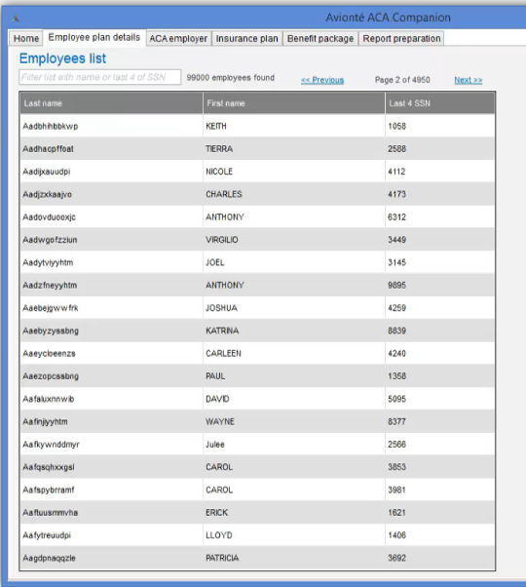
Entering Offers
2 options
  Manual entry
  Data import
Navigate to Employee Plan Details tab in ACA Companion
Search for employee
Double click on name

Slide 22
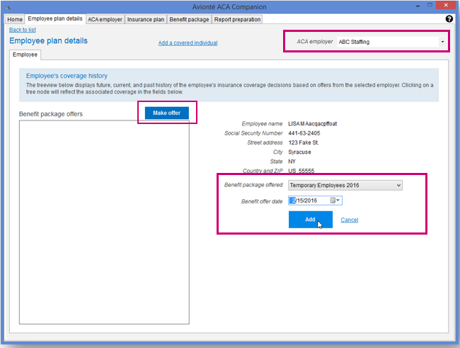
Employee Plan Details
Select ACA Employer in top right corner
Select “Make Offer”
Select Benefit Package
Benefit Offer Date = date employer sent the offer
Click ADD
Notes:
This is the place you use the most after the setup has been completed
Remember to choose your specific employer from the drop down (if more than one)

Slide 23
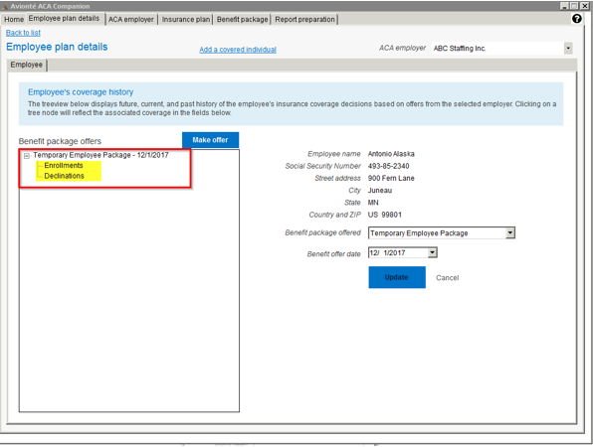
Employee Plan Details
Single click on Enrollment or Declination from the tree to insert employee response
Notes:
Once you select “Add” for your offer of coverage, you will see that offer under your “Benefit Package Offers” box where then you can select if an employee enrolled or declined

Slide 24
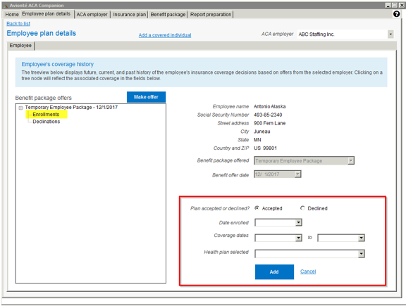
Employee Plan Details
If employee enrolled, single click on “Enrollments” and enrollment box will populate
Add Deductions or Contributions in core application for payroll purposes (Employee>Payroll)
Notes:
Date Enrolled = date the EE said they want to take the offer
Coverage Dates = Super Important! Directly affect 1095 C
Start Date = the date they were covered with insurance
End Date = can leave open, or put in the end date for the plan itself. If EE terminates mid-year, make sure to input that date as the end date
Does not affect 1095 report
For those using the Essential Staffcare integration, completing your weekly imports will populate these deductions

Slide 25
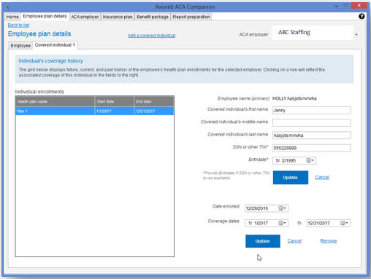
Covered individuals
Need to track if self-insured!
Spouse & Dependents
Need SSN and/or DOB
Enter Date Enrolled
Enter Dates of Coverage (can differ from Employee)
Notes:
Collect the covered individual’s name and birthdate or SSN – usually get from insurance company
Dependent information is not tracked in Avionte!
Coverage Dates = when they actually had insurance through this plan, could be different than the coverage dates for the EE
Shows which months the person was covered on 1095

Slide 26
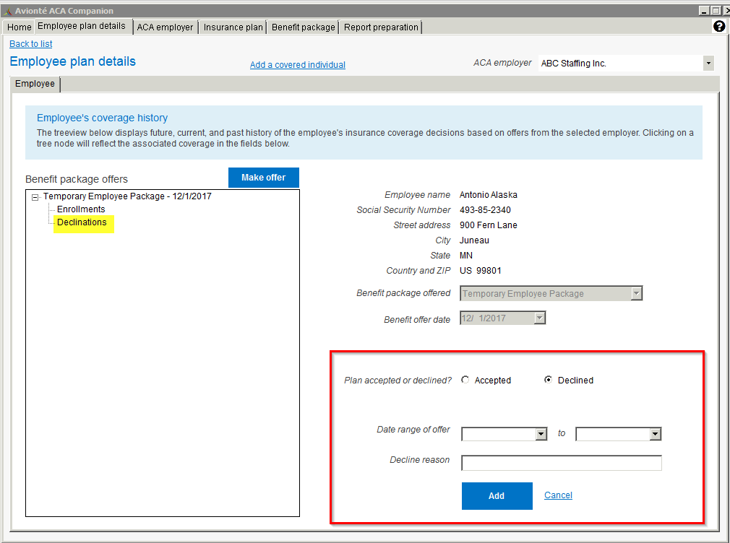
Employee Declines Coverage
If employee declines, single click on “Declinations” and declination box will populate
Notes:
Date range of offer: The range of dates in which the employee was eligible for insurance and able to accept or decline the insurance plan offer
End date should be left blank if they are still currently declining
Decline reason field: A free text field used to describe why the employee declined the insurance plan offer
Click “Add” once declination is completed

Slide 27
Import process
ACA Import
  Imports enrollments & declinations from an Excel spreadsheet
  Mapping required!
  Template available in Knowledge Base article
  Our partner ESC will send you a file in this format
ACA Declination Export AQ
  Enrollments must be added first (manual or through ACA Import)
  Adds declinations for all employees who worked in the reporting year & did not enroll
  Great for employers who offer to all employees upon hire!
Notes:
ACA Import will add enrollments and/or declinations to ACA Companion for reporting. A standard formatted Excel spreadsheet is attached to the bottom of the KB article link. The Declination Export should be run after enrollments are added. It exports a list of employees who are measured/marked as ACA eligible, but who have “concerning” code combinations on their 1095-Cs that would cause red flags. You can export this AQ to Excel, save the file, and re-import it back into Avionte using the ACA Import.
We have some mass update or edit tools you can use
ACA imports – imports enrollments and declinations from a excel spreadsheet
There’s a template for this on the kb
It’s still a good amount of information needed, but it can be done
If you use essential staff care – they will send you a file in this format so you can update that information ACA companion app
Mapping required in admin tools
If you haven’t been tracking declinations
We have a tool called the ACA declination export AQ
Works in tandem with the import
First enter your enrollments into the aca companion
Then, you can run the ACA declination export aq – and it exports a list of employees who were aca full time but have red flag; you were probably offered insurance, but a declination or offer was never entered
Assumes when the offer or declination probably occurred, and then exports that in the aca import format
Make manual changes
Save it and import using the aca import
After you do the imports, you would regenerate your data and review your forms

Slide 28
Resolving errors
Notes:
Let’s talk about the Aca Reporting

Slide 29
Missing data or employees in ACA Companion
MANUAL FIXES
Make fixes in the core application
  Name
  SSN
  Primary address
Reimport Employee Data
Companion Application > Home
MASS UPDATES
Run ACA Companion Employee Sync Error AQ in Reports
  Displays Name, SSN, Address, Last Check Date
Export AQ to Excel
  Edit employee information
Import spreadsheet via Import/Export main menu
Reimport Employee Data
Companion App > Home
Fix ACA Companion Application Employee Sync Errors
Notes:
Same process as resolving errors when initially importing employee information!
This is likely an error that is not allowing the employee’s information to be synced into the ACA Companion.
2 options – manual or mass fix to correct this issue.
Manual: You can make the necessary change in the EE record in core or if you’re missing a lot of EE’s you can run the ACA Companion Employee Sync Error AQ in Reports
Check the error in the ACA Companion home tab- could be the SSN is missing or an address is incomplete
Reference the instructions here on running the ACA companion sync error AQ in reports and making fixes in the core app or in an excel file if you need to do a lot

Slide 30
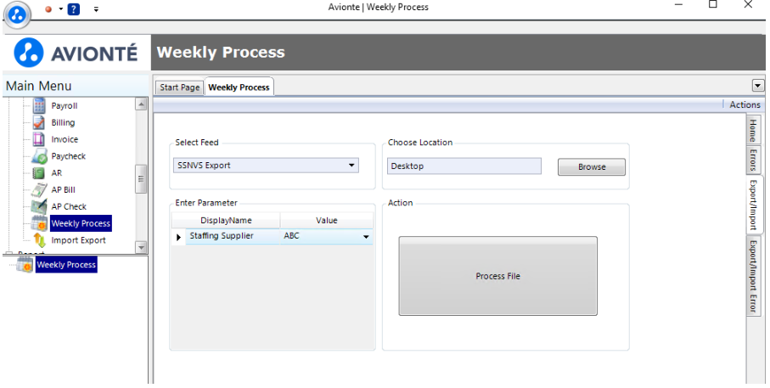
Verify employee SSNs
Free services offered by SSA Business Services Online
Verify names and SSNs of employees against SSA records
Upload electronic files of up to 250,000 names and SSNs (takes at least 1 business day)
Feeds and report setup in Admin Tools >Report
Notes:
When data is generated in the ACA Companion, it then allows you to review the reports to review errors and what is populated on the form.

Slide 31
Reports
Notes:
Let’s talk about the Aca Reporting

Slide 32




ACA Reports
ACA Companion Census AQ
Shows an employee’s total hours and ACA Eligibility as well as wages, benefits, etc
ACA Companion Employee Offers AQ
Displays a list of all offers made in the Companion
ACA Companion Employee Sync Error AQ
List of employees who did not import and why
1095 C & 1094 C Report
Generate the 1095 C and 1094 C reports
CHECK IT OUT
TAKE A LOOK
LEARN MORE
GET STARTED
Notes:
ACA Companion Census AQ: Shows an employee’s total hours and ACA Eligibility as well as total wages, benefits and benefit amounts
ACA Companion Insurance Offers AQ: Displays a list of all offers made in the ACA Companion Application
ACA Companion Employee Sync Error AQ: Shows a list of employees who did not import into the ACA Companion
Displays why an employee did not import and what needs to changed
Needs to be followed by an import to update the employee records

Slide 33
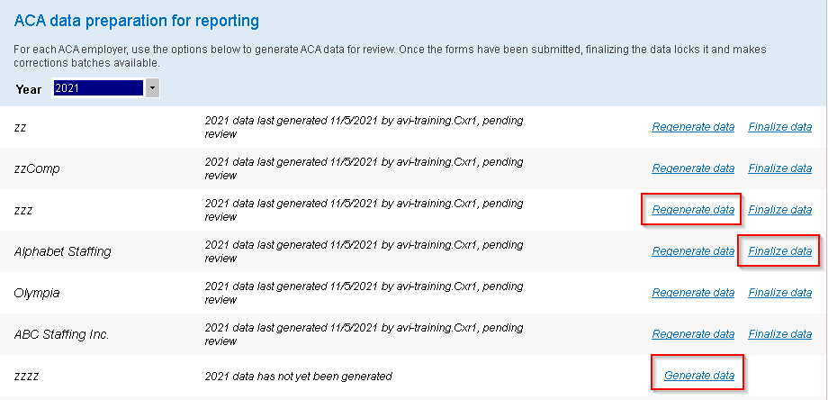
Report Preparation
Generate Data
  Pushes data into reporting table
Regenerate data
  Updates reports if changes are made
Finalize data
  Initiates correction process
  Adjustments will result in corrected 1095-C
  Only done after confirmation from IRS
Notes:
Report Preparation tab in the aca companion
You should see multiple suppliers if you have more than one
Here we see several suppliers
Button options – generate data (after click it the first time, changes to regenerate data) – generate date pushes data into reporting table to produce those 1095-Cs – “process info”
Regenerate data – click to see changes after correcting errors – “process”
Finalize data – don’t click this until you have successfully filed with the IRS and get that confirmation from Greenshades – point of no return – anything after this is a corrected form
POST

Slide 34
Electronic Consent

Slide 35
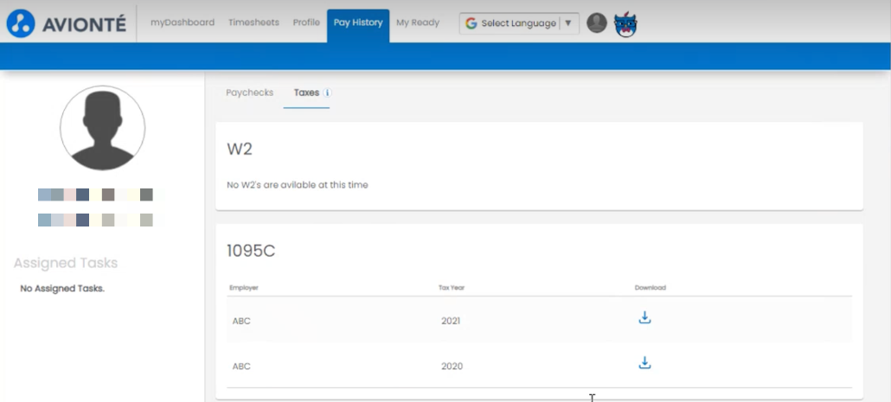
Gather Electronic consent
Electronic delivery of 1095-C to the Talent portal in BOLD
Opportunity to gather consent during onboarding using ADOBE integration
Use ADOBE mapping fields for 1095-C Consent mappings
Setup the Electronic 1095-C and make visible in Talent portal
Notes:
Another activity that can occur throughout the year is gathering employee consent for the electronic delivery of employee year-end tax forms, including the 1095-C. Employees that have consented to electronic delivery don’t require a mailed copy which can reduce the forms your company needs to mail, saving both time and money in January. Once opted into consent, instead of mailing them, you can simply post the tax forms to the employee portal for talent to easily access, the same way they do their paychecks.
A leading practice that is common among our clients is to present the opportunity for employee consent during onboarding. Using Avionte BOLD and our integration with ADOBE, our BOLD clients can create a form to gather that consent.
As the Adobe administrator with access to our Adobe account, I can create an ADOBE form. Avionte has provided Adobe mapping fields that ensure the data completed on the form flow into the employee’s record, specifically whether the employee consents or not.
This Knowledge Base article will provide all of the available mappings so that the form can be set up accurately to push the data into the employee’s record. The article also has a training video on how to complete and build Adobe forms so we won’t cover the form creation process in detail here today.
Can send out individually or using mass action. Can also us the Announcements feature to announce when they are posted on the Talent portal.

Slide 36
Helpful Resources

Slide 37




Additional resources
AVIONTÉ UNIVERSITY
Interactive on-demand eLearning.
SUPPORT CENTER
Tickets and guide articles.
WEBINARS
Live virtual training hosted monthly.
BOLD BULLETIN
Weekly newsletter.
NOTE: Your account manager is always happy to help. If you have questions, be sure to reach out!
Notes:
Read BOLD Bulletin for ACA Updates

Slide 38
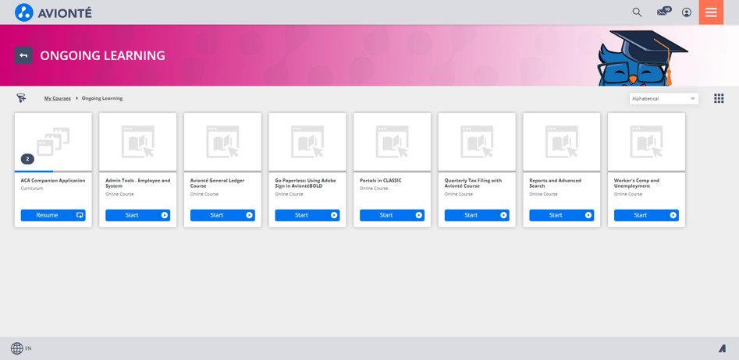
Avionte University Courses
ACA
ACA Companion set up
ACA 1094-C and 1095-C Reporting
Notes:
2 courses – ACA Companion Setup and ACA 1094-C and 1095-C Reporting

Slide 39
Knowledge Base highlights
ACA DIRECTORY
Links to helpful ACA year-end articles and training modules
SSNVS FEEDS
Export up to 250,000 names and SSNs to verify employees against SSA records using BSO
YEAR-END
Preparing for Year-End – CONNECT 2022 session Cheat sheet
ACA SECTION
Collection of all articles related to the Avionté ACA solution
CHECK IT OUT
TAKE A LOOK
LEARN MORE
GET STARTED
Notes:
Helpful KB articles – ACA and Taxes directory help you locate the most useful and thorough year-end related

Slide 40
Q&A

Slide 41
Thanks!

Slide 42
Year-End Checklist
AUGUST, SEPTEMBER,OCTOBER
☐ Verify employee SSNs
☐ Gather consent for electronic delivery of 1095-Cs
☐ Create Adobe electronic consent form and distribute to employees not yet consented
☐ Confirm you are receiving the weekly Avionté BOLD Bulletin
☐ Register HERE if you aren’t subscribed!
☐ Review 2022 insurance plan(s) and benefit package(s) set up in the ACA Companion
☐ Add or update insurance plans as needed
☐ Add or update benefit packages as needed
☐ Review ACA Full Time status of employees using ACA Companion Census AQ
☐ Review insurance offers for ACA reporting using the ACA Companion Employee Offers AQ to view 2022 enrollments and declinations
☐ Review ACA Full Time w/o Offer counter to determine if current ACA full time employees need an insurance offer.

Slide 43
Year-End Checklist
AUGUST,SEPTEMBER, OCTOBER (CONTINUED)
☐ Need to enter offers in the ACA Companion?
Make a plan to enter insurance offers: manual entry or data import
☐ Learn about entering in dependents
☐ Update insurance offer dates in the ACA Companion as employees terminate
☐ If missing declinations in the ACA Companion, learn about the ACA Declination Export option.
☐ Start and end assignments with accurate dates; correct as needed
NOVEMBER & DECEMBER
☐ Resolve any remaining ACA Companion sync errors
☐ Generate 1095-C forms and start to review
☐ Review forms for accuracy by running the Get Employee 1095-C Info AQ and reviewing codes (reminder, December won’t be populated yet)

Slide 44
Year-End Checklist
JANUARY
☐ Regenerate 1095-C forms and do a final 1095-C review/audit
☐ Use our code population guide to understand how the 1095-C codes are determined
☐ Use overrides as needed
☐ Print and mail forms to workers
☐ 1095-C
☐ Post forms to the employee portal
☐ 1095-C
AFTER JANUARY
☐ Completed 1095-C corrects as necessary

